Slide 1
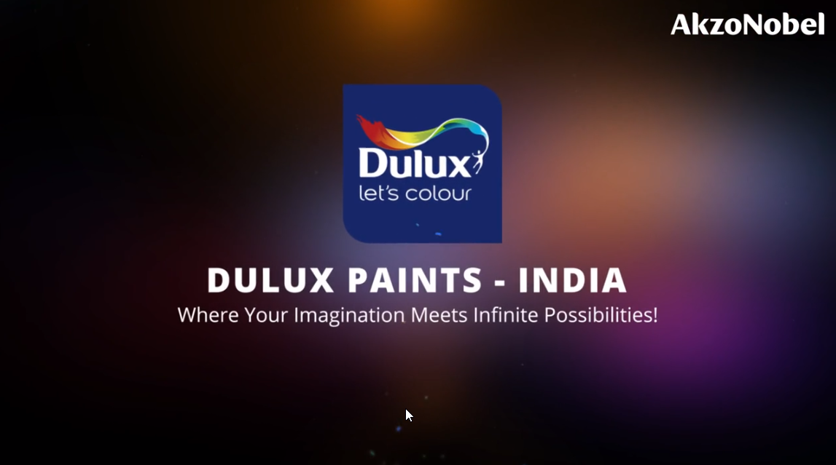
MALAYSIA
Notes:
VO:Welcome to the vibrant world of colors with Dulux Paints Malaysia; where your imagination meets infinite possibilities. Click Start to begin.
Developer Notes: This is the standard starting animation that will play. Start button to be highlighted so that users knows he/she has to click it.

Slide 2
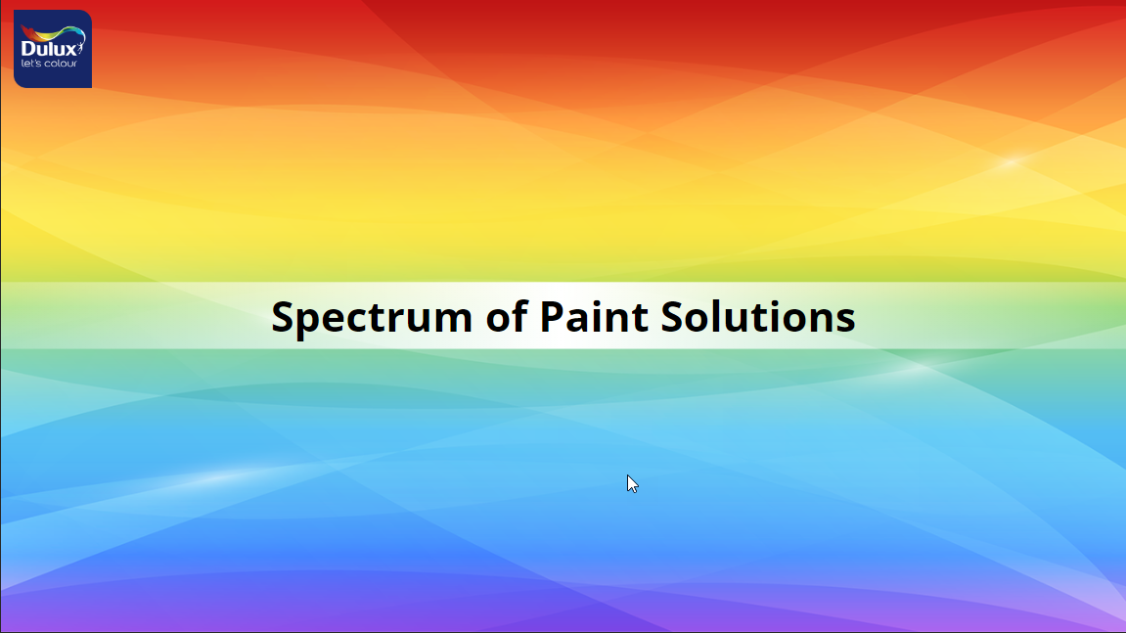
Notes:
VO: We offer a spectrum of paint solutions each catering to specific needs and aesthetics.

Slide 3



INTERIOR PREMIUM WALL PAINT
INTERIOR MASS & ECONOMY WALL PAINT
EXTERIOR PREMIUM WALL & ROOF PAINT
EXTERIOR MASS WALL PAINT
TRIMS PREMIUM PAINT
TRIMS MASS PAINT
WATERPROO-FING PREMIUM PAINT
PRE DECO
Click each tile to know more about the specifics of that category
Notes:
Voiceover (VO): Our Categories include the following: (Animate the rectangles in sync with audio)
INTERIOR PREMIUM WALL PAINT
INTERIOR MASS & ECONOMY WALL PAINT
EXTERIOR PREMIUM WALL & ROOF PAINT
EXTERIOR MASS WALL PAINT
TRIMS PREMIUM PAINT
TRIMS MASS PAINT
WATERPROOFING PREMIUM PAINT
PRE DECO
OST: Click each tile to know more about specifics of that category.
Developer Notes: The shapes should be clickable. Clicking the shape should take it to the respective section of the course. This should be open navigation, use can click any of the shapes first to begin. On Mouse hover, the colour of the shape should change and it should be highlighted. Once visited, there should be a tick mark on the shape to denote that it has already been viewed.

Slide 4
INTERIOR PREMIUM WALL PAINT
Notes:
Developer Notes: This section should be played when the user selected the tile Interior Premium Wall Paint.

Slide 5
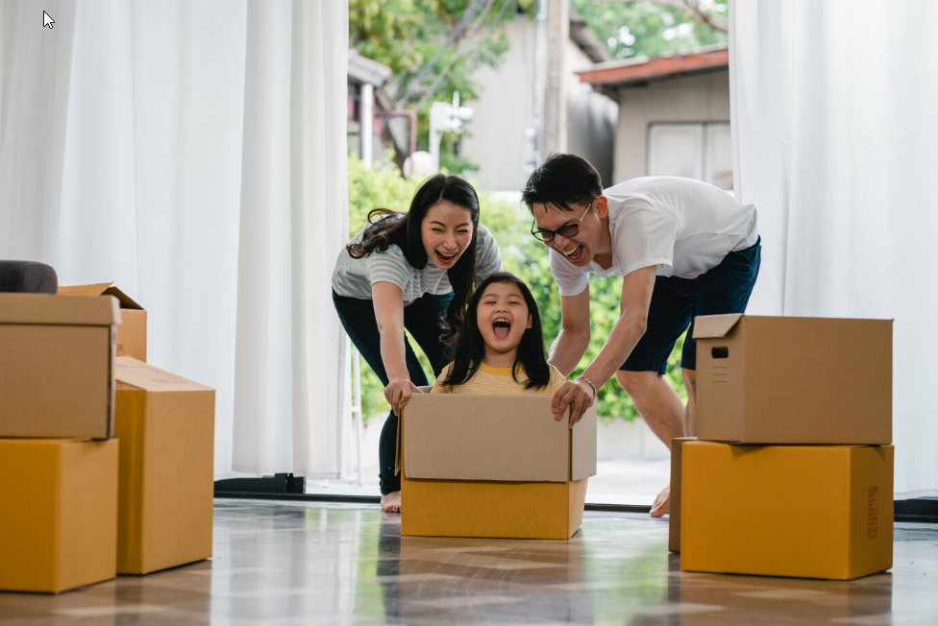


Introduction to scenario
Notes:
Photo link: https://www.freepik.com/free-photo/happy-asian-young-family-having-fun-laughing-moving-into-new-home-japanese-parents-mother-father-smiling-helping-excited-little-girl-riding-sitting-cardboard-box-new-property-relocation_6142472.htm#query=relocation%20malaysia&position=13&from_view=search&track=ais&uuid=317c2f39-0eda-4b93-8552-2dde1f0da1fb
Single boy: https://www.freepik.com/free-photo/portrait-cute-little-boy-standing-with-arms-folded-looking-camera_3175259.htm#query=asian%20toddler&position=6&from_view=search&track=ais&uuid=9d423f74-440a-4368-91ea-27177e11828a
VO: Ahmad and his family are moving into their new home. They want their home to look stunning, colourful and be a reflection of their personalities. Above all, they would like their home to be safe, easy to clean and stain resistant. Ahmad is confused with the wide variety of paints and colours to choose from, lets help him to select the best option for his needs. Click next to proceed.
Notes to developer: Need to do a slow zoom in this image while the voice over is being narrated.

Slide 6
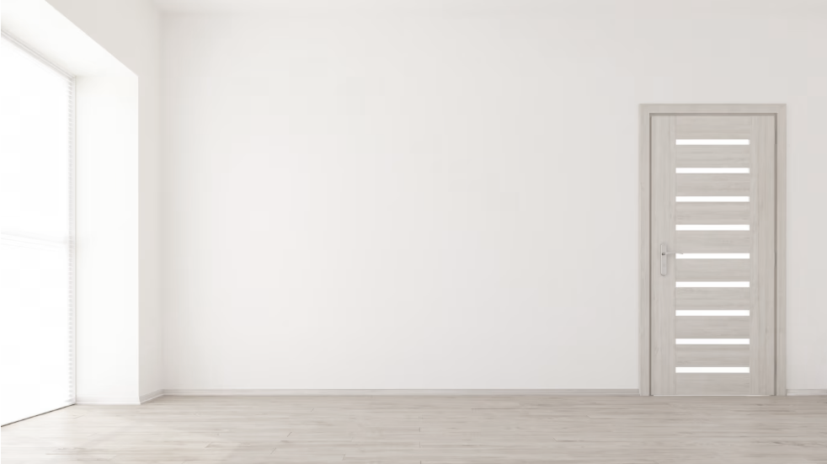
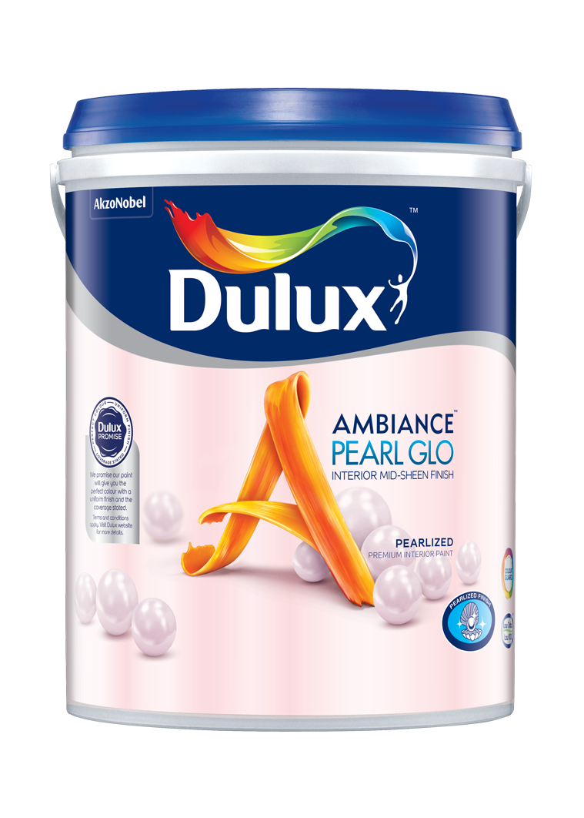
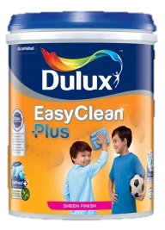
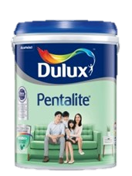
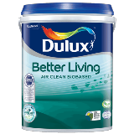
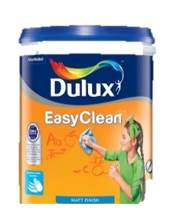

INTERIOR PREMIUM WALL PAINT
Dulux Better Living Air Clean Biobased
Dulux Ambiance Pearl Glo
Dulux EasyClean Plus /EasyClean
Dulux Pentalite
I’m confused, how do I choose the best paint for me?
Click on each type to learn more
Notes:
VO: Dulux offers a variety of paint solutions for various needs.
Let's help Ahmad select the right kind of paint to customize each of the rooms in his new home. (The thought bubble appears after the paints are displayed one by one)
OST: Click on each type to learn more.
Image referece:1. https://www.freepik.com/free-photo/3d-render-empty-room-interior_5027779.htm#query=new%20home%20empty&position=14&from_view=search&track=ais&uuid=3d7d3747-a661-4529-80e0-83bfd7f478da (background)
2. https://www.freepik.com/free-photo/pensive-man-eyeglasses-looking-aside_7370466.htm#query=asian%20man%20glasses&position=18&from_view=search&track=ais&uuid=8d52b750-945b-4792-97a7-d252abbb4084
(Asian Man thinking keywords)

Slide 7
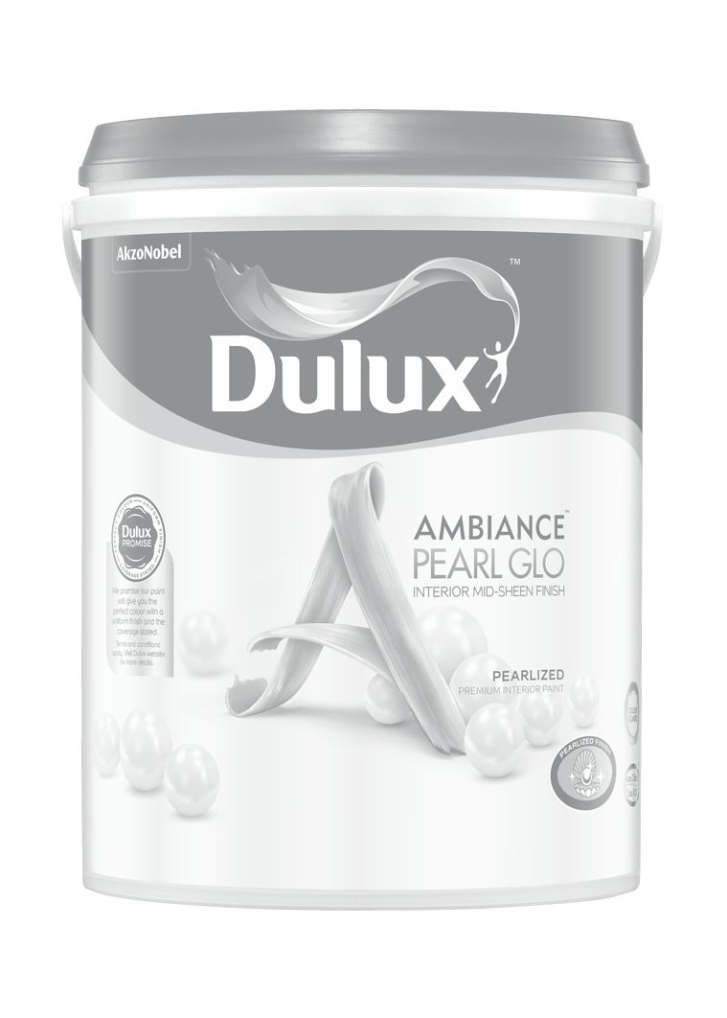
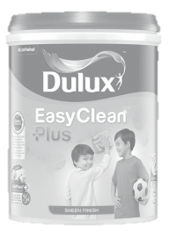
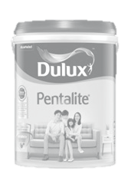
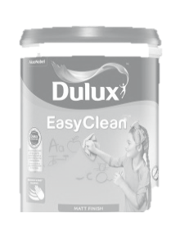
INTERIOR PREMIUM WALL PAINT
Dulux Better Living Air Clean Biobased
Dulux Ambiance Pearl Glo
Dulux EasyClean Plus /EasyClean
Dulux Pentalite
Click on each type to learn more
Notes:
Developer Reference: This slide to be shown when user clicks Dulux Better Living Air Clean Biobased

Slide 8
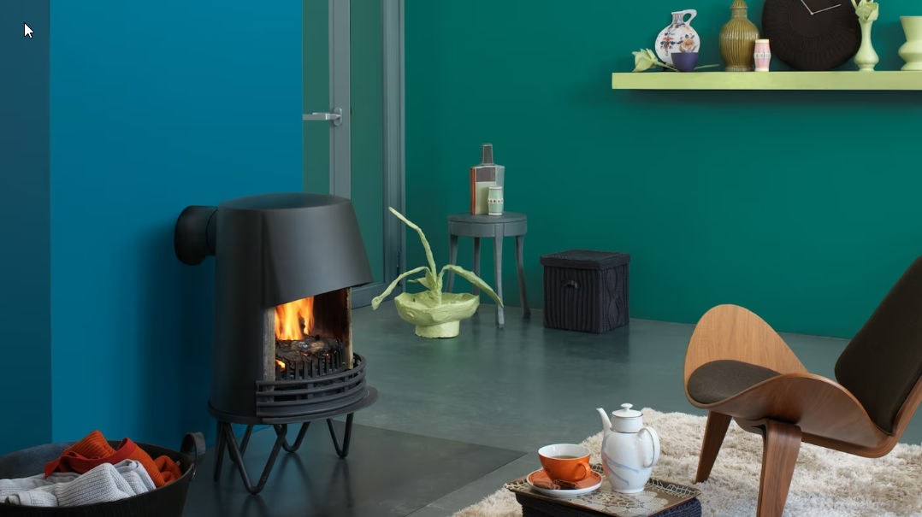

Problem Statement:
Click this thought bubble to see Ahmad’s thought.
Click on Ahmad to understand what he is thinking.
Notes:
OST: Click on Ahmad to understand what he is thinking.
VO: 1. Ahmad wants his living room to be airy, fresh and with natural elements. He also wants the paint to be environmentally friendly and help with maintaining proper air quality inside the living room.
Image Ref: https://www.freepik.com/free-photo/minimalist-interior-design_72291465.htm#from_view=detail_serie
Character photo ref: https://www.freepik.com/free-photo/young-asia-businessman-using-computer-laptop-talk-colleagues-about-plan-video-call-meeting-while-working-from-home_14323589.htm#&position=6&from_view=author&uuid=1d496521-9dcc-4a6f-9e7f-20a9bc6c566f

Slide 9
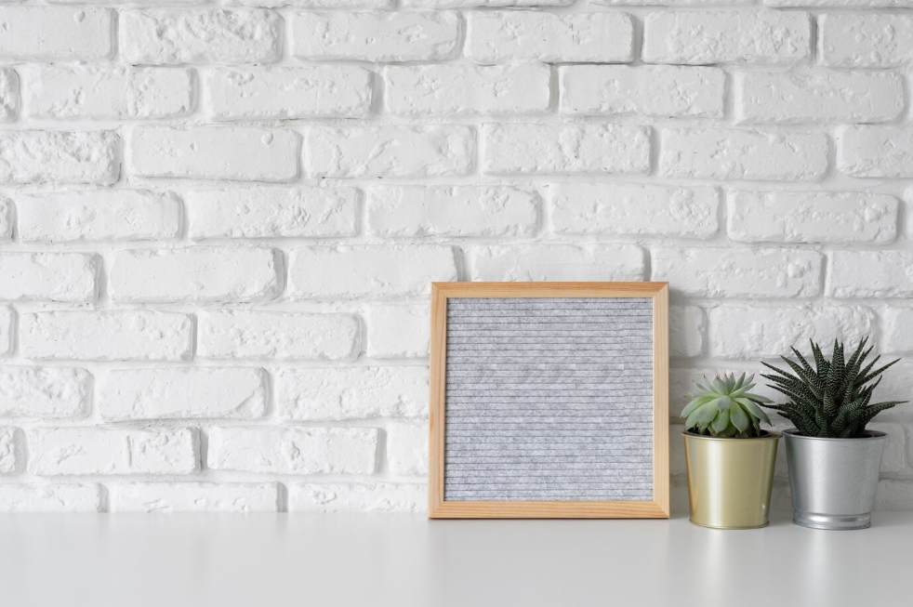
Introduction
Dulux Better Living Air Clean Biobased
Notes:
VO: Dulux Better Living has a unique PureAir technology that uses biobased ingredients and this property allows it to purify indoor air. It does this by reducing harmful impact of formaldehyde and other VOCs. Let’s see how this is the perfect solution for Ahmads living room. Click next to proceed. (Use the female Narrator voice)
Image: https://www.freepik.com/free-photo/creative-inspirational-resource_19869962.htm#query=blank%20brick%20wall%20with%20a%20table&position=27&from_view=search&track=ais&uuid=c123f59f-07f7-45ad-ae22-655b8ebea06e

Slide 10



Benefits
USDA Certified
Cleans the air
Natural ingredients and environmentally friendly
Notes:
VO: (plays after paint can is shown). The Dulux Better Living series of paints is USDA certified and it helps clean the internal air by removing harmful impacts of formaldehyde and other Volatile Organic Compounds (commonly called VOCs). Also, it is made using naturally occurring ingredients such as active bamboo charcoal and is therefore environmentally friendly too. This is perfect based on Ahmad’s requirements.
Animation Description: Bring an image of the Dulux Better Living sliding from right side into the frame. Character expression should change from being thoughtful to smiling once the paint image is shown. The 3 bullet points should be displayed in synchronisation with the spoken audio. (Also, 3 icons at the top to appear in sync with audio)
Image Ref: https://www.freepik.com/free-photo/minimalist-interior-design_72291465.htm#from_view=detail_serie
Character photo ref: https://www.freepik.com/free-photo/young-asia-businessman-using-computer-laptop-talk-colleagues-about-plan-video-call-meeting-while-working-from-home_14323589.htm#&position=6&from_view=author&uuid=1d496521-9dcc-4a6f-9e7f-20a9bc6c566f

Slide 11
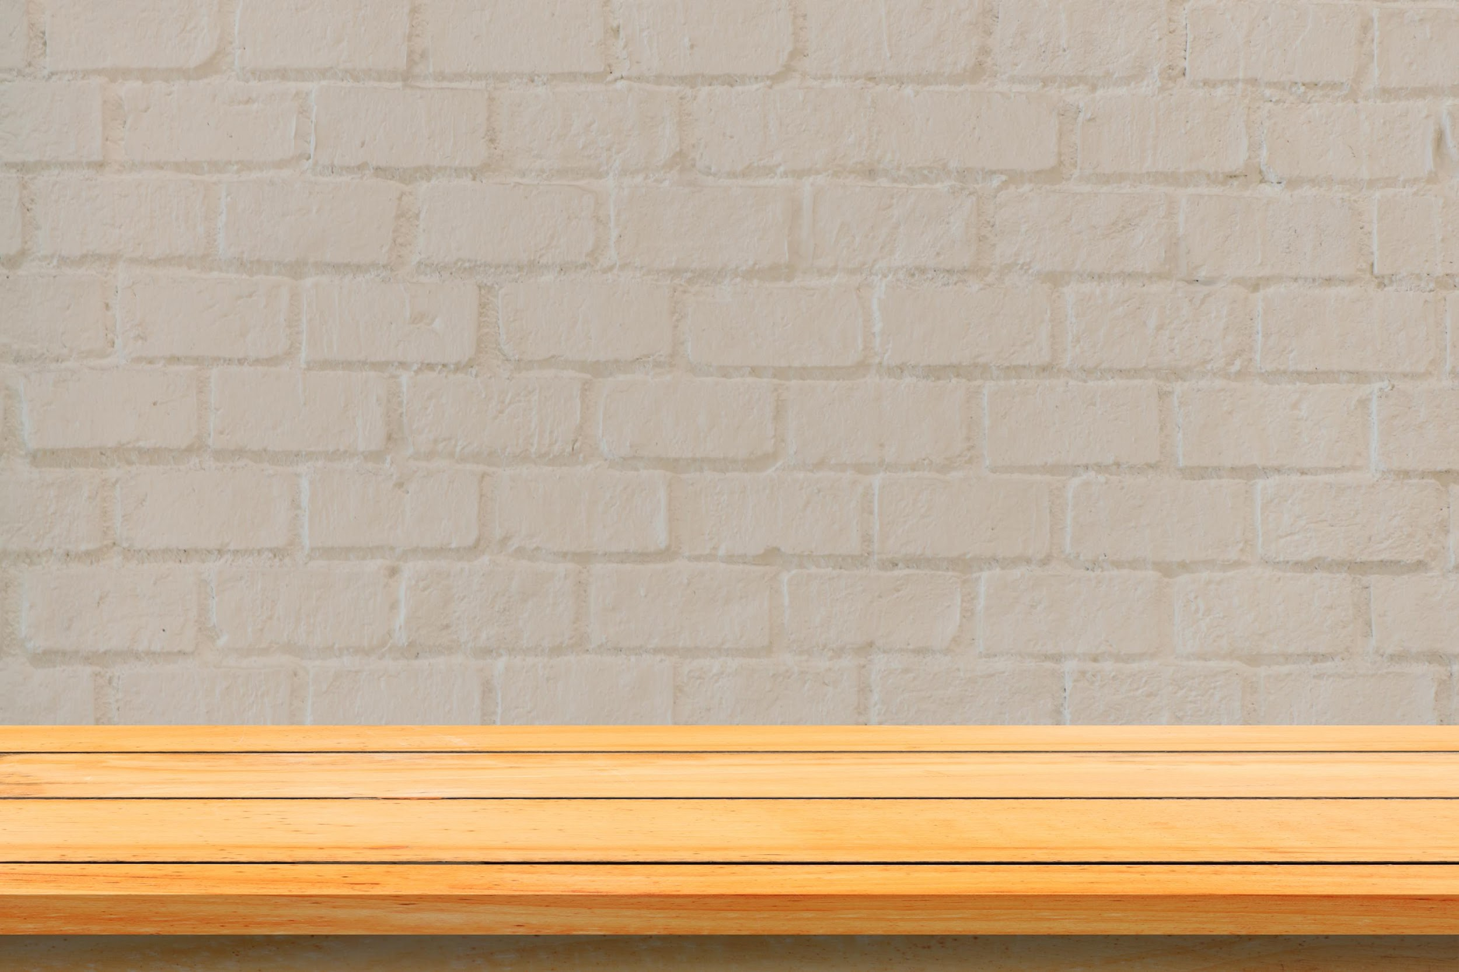






Features
Coverage: 11-12 mt²/Lt
mts²
Finish: Sheen
Drying time:
2-3 hrs
Anti Bacterial
>1200 shades
Water based
1L, 5L buckets
Click the product to learn more.
Notes:
VO: Let's now unlock some extraordinary features that set Dulux Better Living. Click the product to learn more.
Water based environmentally friendly.
Anti bacterial and anti fungal properties
Finishes with a good sheen and luster
Cover more space with less paint, with 11-12 square meters per liter.
Quick drying time of 2-3 hours.
Choose from over 1200 soft pastel colors to personalize your space.
Available in 2 sizes, which are1L, 5L buckets.
Developer Notes
Show OST in sync with the VO (User needs to click only once, and the icons appear one after the other in sync with audio)
*******EXISTING ICONS FROM INDIA STORYLINE FILE CAN ALSO BE USED INSTEAD OF THIS DEPENDING ON CLIENT REQUIREMENT. PLEASE CONFIRM WITH PROJECT MANAGER WHICH ICONS ARE BETTER TO BE USED IN THE STORYLINE FILE ************
Icon references: (For icons on this page)
Water Based Icon: https://www.flaticon.com/free-icon/water-drop_3105761?term=water&page=1&position=2&origin=search&related_id=3105761
Anti bacterial: taken from previous SB (India specific SB)
Shine: https://www.flaticon.com/search?word=shine
Coverage: Created by Me
Time: taken from PPT icons
Colors: Taken from previous India SB
Paint can: https://www.flaticon.com/free-icon/paint-can-open_81980?term=paint+cans&page=1&position=3&origin=search&related_id=81980
Paint quantity: Created by me using above paint can and scale created myself.

Slide 12
Result :
Notes:
As a result, Ahmad has his living room painted in environmentally friendly and safe colors. Now let us move to the next room.
Developer Notes
Show Ahmad looking happy. He has fresh walls with clean air.
Navigate to Slide 6 again once this slide is over so that user can select next/different paint bucket
Image links: https://www.freepik.com/free-photo/minimalist-interior-design_72291465.htm#from_view=detail_serie

Slide 13
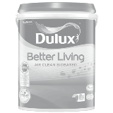
INTERIOR PREMIUM WALL PAINT
Dulux Better Living Air Clean Biobased
Dulux Ambiance Pearl Glo
Dulux EasyClean Plus /EasyClean
Dulux Pentalite
Click on each type to learn more
Notes:
Developer Notes: Imagine the user wants to select the second option here which is Dulux Ambiance Pearl Glo.

Slide 14

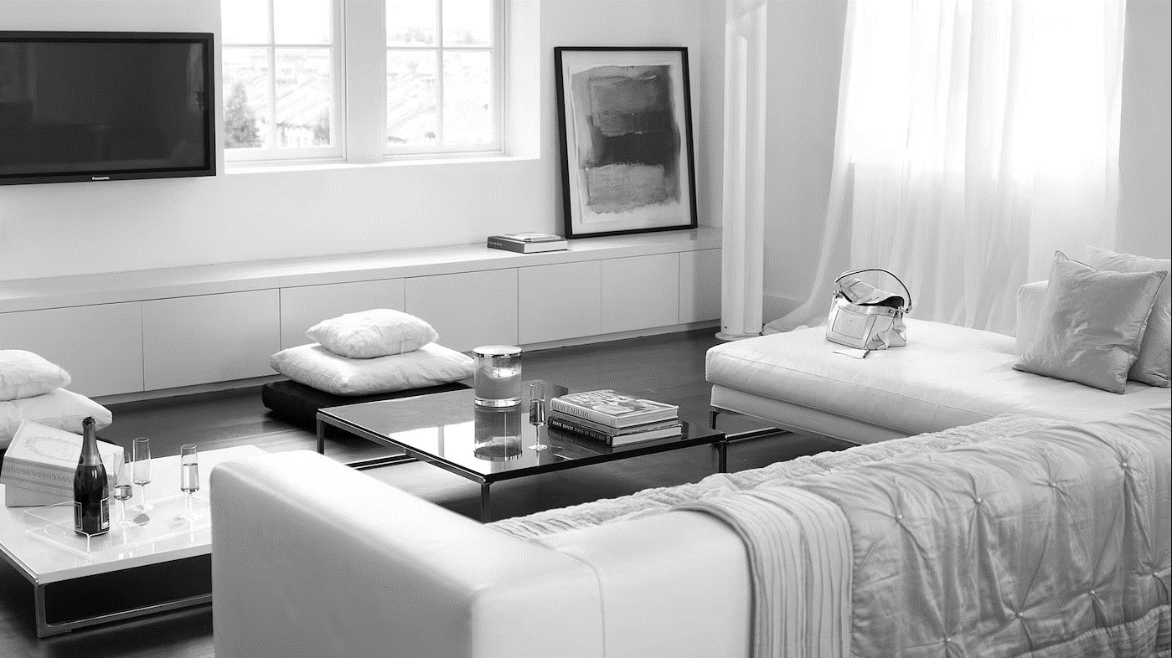
Problem Statement:
Click this thought bubble to see Ahmad’s thought.
Notes:
VO: Ahmad wants to show off his new house to all his friends and relatives. He wants it to have a contemporary style with latest trendy colours and an attractive interiors. He would like the best paints to be used in his dining area. Let’s see how Dulux Ambiance Pearl Glo is the best choice for his needs.
Developer Notes: Navigate to Slide 6 again once this slide is over so that user can select next/different paint bucket
Image ref: https://images.akzonobel.com/akzonobel-flourish/dulux/in/dulux/en/articles/channel-modern-luxury-shades-ivory/channel-modern-luxury-with-shades-of-ivory_2.jpg?impolicy=.auto&imwidth=1366
Person Image: https://www.freepik.com/free-photo/expressive-young-guy-posing-studio_16925389.htm#&position=11&from_view=author&uuid=5957b8f4-ad4f-41bc-9352-ea2e062fa5df

Slide 15

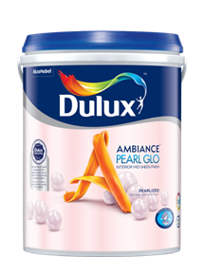
Introduction – Ambiance Pearl Glo
Dulux Ambiance Pearl Glo
Notes:
VO: Dulux Ambiance Pearl Glo has an attractive pearlized mid-sheen finish provides a timeless & elegant look to your room. It has a shimmery texture and gives off a rich look to your walls.
Image: https://www.freepik.com/free-photo/creative-inspirational-resource_19869962.htm#query=blank%20brick%20wall%20with%20a%20table&position=27&from_view=search&track=ais&uuid=c123f59f-07f7-45ad-ae22-655b8ebea06e

Slide 16

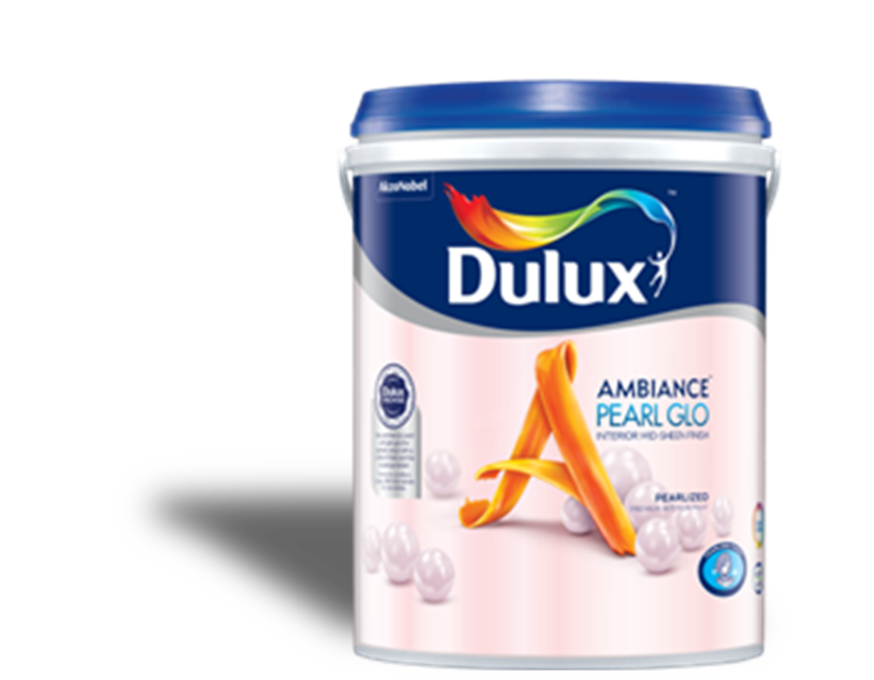


Benefits
Pearlized Mid Sheen
Long Lasting colours
Notes:
VO: (plays after paint can is shown). The Dulux Ambiance Pearl Glo is a unique offering that has a pearly mid-sheen finish. It gives a timeless look and is a long lasting paint. Click next to view the detailed features. Click next to view the detailed features.
Animation Description: Bring an image of the Dulux Ambiance sliding from left side into the frame. Character expression should change from previous slide. The 2 bullet points should be displayed in synchronisation with the spoken audio. Icons to appear in sync with audio and text too.
Character: https://www.freepik.com/free-photo/expressive-young-male-posing-studio_16925419.htm#&position=1&from_view=author&uuid=5957b8f4-ad4f-41bc-9352-ea2e062fa5df

Slide 17
Features
Coverage: 11-12 mt²/Lt
Drying time:
2-3 hrs
mts²
Finish: Pearlized Mid Sheen
>2500 shades
Water based
1L, 5L & 18 L
Click the product to learn more.
Notes:
VO: Let's now unlock some extraordinary features that set Dulux Ambiance Pearl Glo. Click the paint icon to learn more.
Water based environmentally friendly.
Finishes with a pearly mid-sheen finish
Cover more space with less paint, with 11-12 square meters per liter.
Quick drying time of 2-3 hours.
Choose from over 2500 colors to choose from.
Available in 2 sizes, which are1L, 5L & 18L buckets.

Slide 18

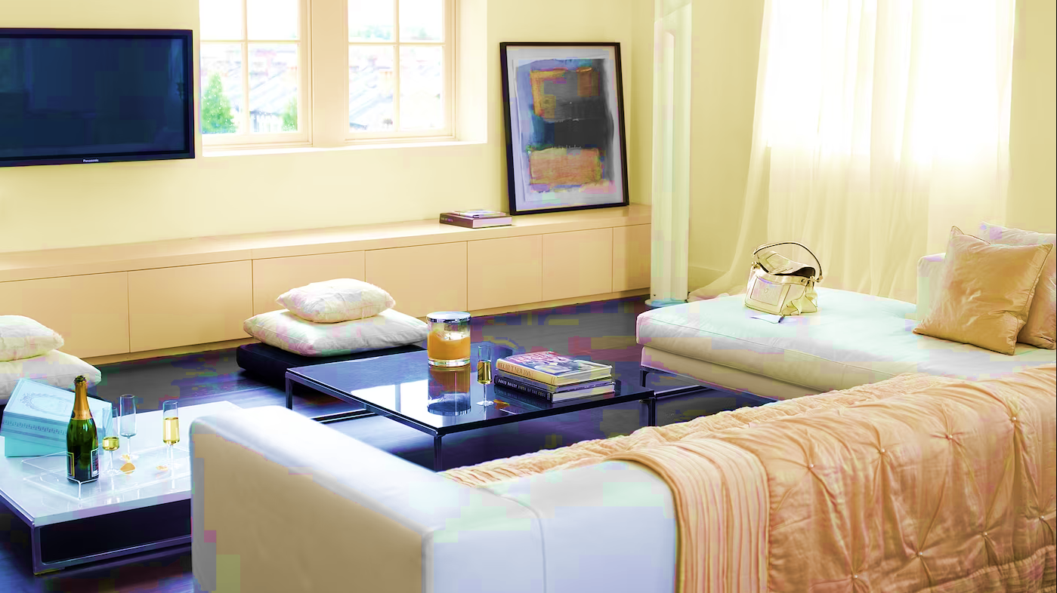
Results
Notes:
As a result, Ahmad has his living room painted in an attractive and long lasting paint coating with a timeless look.
Developer Notes
Show Ahmad looking happy. His living room looks timeless and elegant.
2 Navigate to Slide 6 again once this slide is over so that user can select next/different paint bucket
Image Ref: https://www.freepik.com/free-photo/expressive-young-guy-posing-studio_16925350.htm#&position=3&from_view=author&uuid=5957b8f4-ad4f-41bc-9352-ea2e062fa5df#position=3

Slide 19

INTERIOR PREMIUM WALL PAINT
Dulux Better Living Air Clean Biobased
Dulux Ambiance Pearl Glo
Dulux EasyClean Plus /EasyClean
Dulux Pentalite
Click on each type to learn more

Slide 20
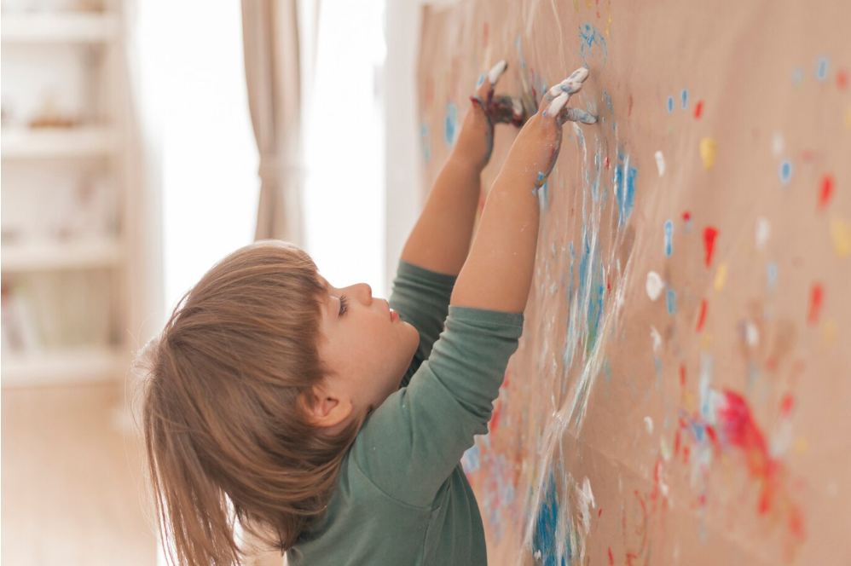
Problem Statement:
Notes:
VO: Maria and Ahmad are parents of two children aged 6 and 3. These little artists are fond of creating artwork everywhere including the walls in the house. Maria and Ahmad are looking for a solution where their walls look beautiful and yet are washable and easy to clean. Let’s check what Dulux has to offer them in this situation. Click next to proceed.
Image Ref: https://www.freepik.com/free-photo/little-child-painting-like-artist_4653983.htm#page=3&query=asian%20kid%20painting%20walls&position=2&from_view=search&track=ais&uuid=612b4766-1cba-4e6f-978c-f674f0fb95f3

Slide 21
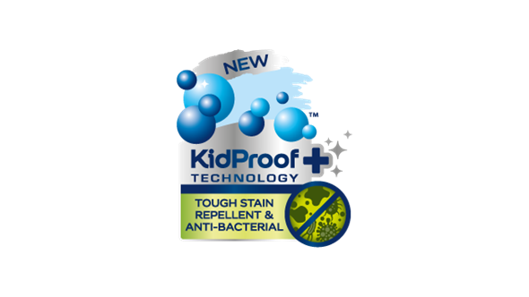

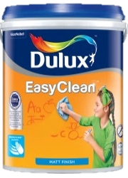

Introduction
Dulux EasyClean Plus and
Dulux EasyClean
Notes:
VO: Dulux Easy Clean and Easy Clean Plus are two products which are don’t allow common household stains from penetrating into the paint. They can be easily wiped away, leaving walls looking fresh and clean. They have colour guard technology and Kidproof+ technology (EasyClean Plus) which keep walls looking clean and fresh for years. The difference between these two are the types of finish it provides. One has a sheen finish(EasyClean Plus), while the other has a matt finish (EasyClean) Let’s look at the detailed features next. Click next to proceed.
Image: https://www.freepik.com/free-photo/creative-inspirational-resource_19869962.htm#query=blank%20brick%20wall%20with%20a%20table&position=27&from_view=search&track=ais&uuid=c123f59f-07f7-45ad-ae22-655b8ebea06e

Slide 22
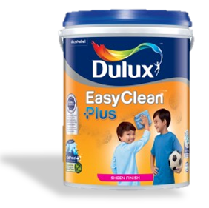
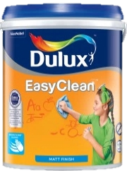


Benefits
Sheen Finish
Matt Finish
Kidproof+ technology
ColourGuard Technology, Easy Cleaning Function
Antibacterial and
Anti virus protection
Antibacterial protection
Notes:
VO: (plays after paint can is shown). The Easy Clean Plus range comes in either a Sheen finish and has advanced Kidproof+ technology in it. It allows for easy cleaning of stains, and also protects against bacteria and viruses. While the EasyClean range comes with ColourGuard Technology. This makes walls resistant to permanent stains by having easy to clean properties. This ensures that walls remain looking fresh and clean for longer periods as compared to traditional paint finished. Click next to view the detailed features.
Animation Description: Bring an image of the Dulux Ambiance sliding from left side into the frame. The two sets of 3 bullet points should be displayed in synchronisation with the spoken audio. Icons can appear and disappear along with audio.

Slide 23
Coverage: 11-12 mt²/Lt
Features
mts²
Anti Bacterial
Drying time:
2-3 hrs
Finish: Sheen / Matt
>2500 shades
Water based
1L, 5L & 18 L
Click the product to learn more.
Notes:
VO: Let's now unlock some extraordinary features that set Dulux Easy Clean and EasyClean Plus. Click each icon to learn more.
Water based environmentally friendly.
Anti bacterial and anti fungal properties
Finishes with a sheen for Dulux EasyClean Plus and a matt finish for the Dulux Easy Clean.
Cover more space with less paint, with 11-12 square meters per liter.
Quick drying time of 2-3 hours.
Choose from over 1200 soft pastel colors to personalize your space.
Available in 2 sizes, which are1L, 5L buckets.

Slide 24

Results
Notes:
VO: Thanks to Dulux’s Dulux EasyClean Plus and Dulux EasyClean products, Maria and Ahmad can be assured that their children have the freedom to have fun, and their walls will also stay fresh and clean.
Image Reference: https://www.freepik.com/free-photo/smiling-portrait-girl-standing-against-white-brick-wall-holding-paintbrush-colorful-palette_4142123.htm#page=4&query=asian%20kid%20painting%20walls&position=13&from_view=search&track=ais&uuid=612b4766-1cba-4e6f-978c-f674f0fb95f3
Navigate to Slide 6 again once this slide is over so that user can select next/different paint bucket

Slide 25
INTERIOR PREMIUM WALL PAINT
Dulux Pentalite
Dulux Better Living Air Clean Biobased
Dulux Ambiance Pearl Glo
Dulux EasyClean Plus /EasyClean
Click on each type to learn more

Slide 26
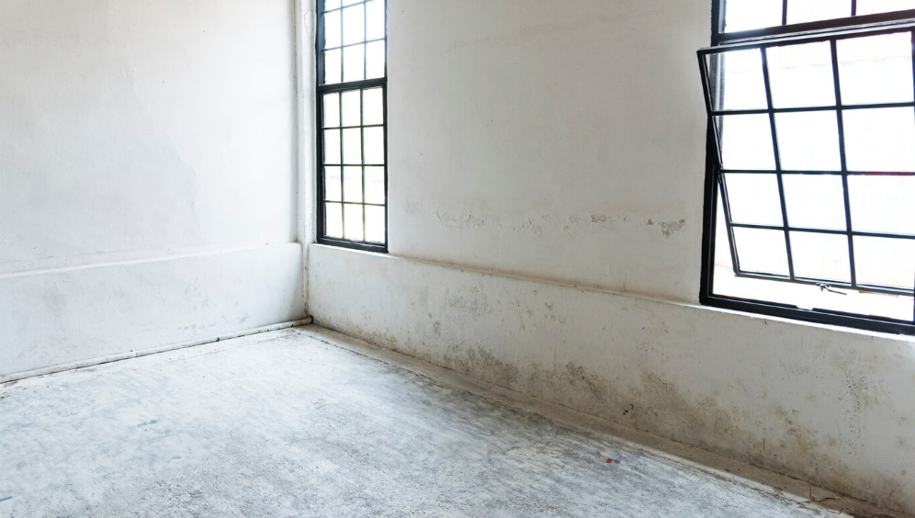

Problem Statement:
Damp walls, fungal infections, sick kids…
Notes:
VO: Due to the Prescence of dampness in walls and ceilings, mould and fungus appear that not only spoils the look of the house but also is harmful to health. Maria is worried about the health and wellbeing of her children and her family and wants to safeguard them against any infections that may occur due to dampness and fungi.
Visual Description: Worried looking Maria is thinking about potential damage being caused by dampness and other bacterial infections.
Image links:
https://www.freepik.com/free-photo/clean-windows-empty-white-house-blank_3012151.htm#query=dull%20and%20damaged%20interior%20walls&position=36&from_view=search&track=ais

Slide 27
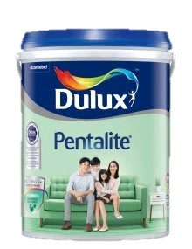
Introduction
Dulux Pentalite
Notes:
We have the Dulux Pentalite that contains unique ProCover+ & Hygiene+ ingredients that give it ability to combat disease causing mould & fungus. This helps keep your homes protected and looking good and also cares for your family’s health at the same time.

Slide 28
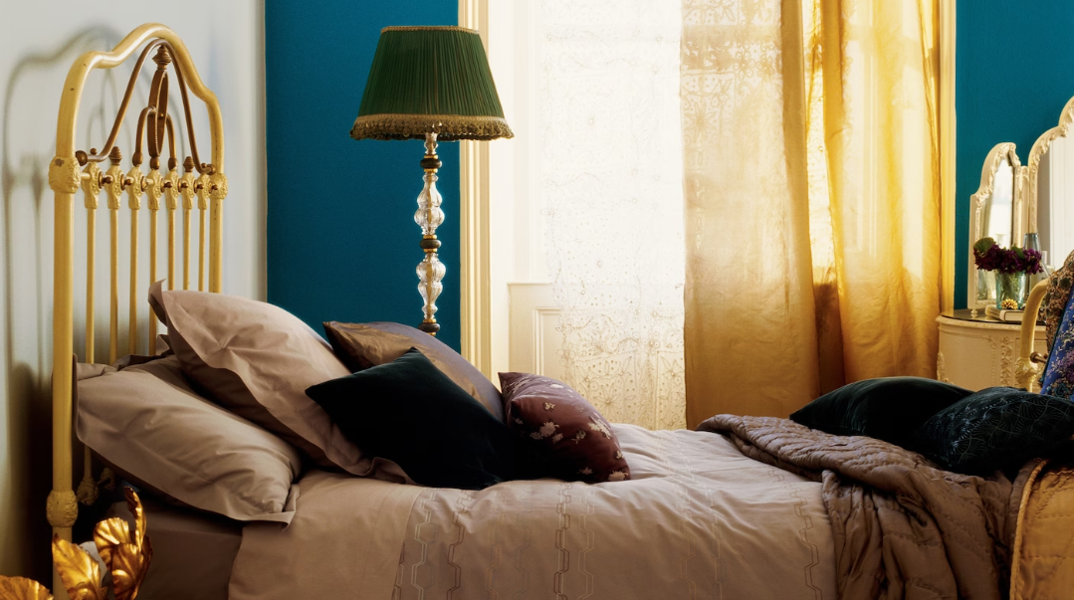
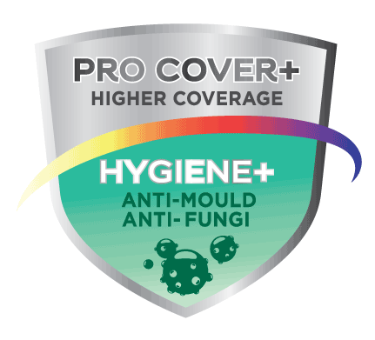
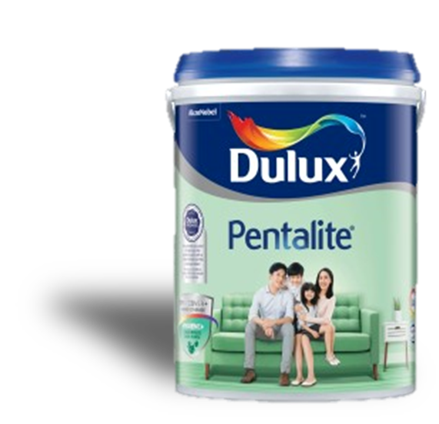
Benefits
Hygiene+ properties
ProCover+ protection
Antibacterial and
Anti virus protection
Notes:
VO: (plays after paint can is shown). The Dulux Pentalite has Hygiene+ properties and ProCover+ Protection in it. The anti-mould & fungal protect your loved ones from pathogens and also keep your walls from showing damp patches which spoil the look of your home. You get a happy healthy and good looking home with Dulux Pentalite. Click next to view the detailed features.
Animation Description: Bring an image of the Dulux Pentalite sliding from left side into the frame. The two sets of 3 bullet points should be displayed in synchronisation with the spoken audio.
Image Ref: https://www.dulux.in/en/colour-inspiration/inject-shot-glamour-deep-teal

Slide 29
Features
Coverage: 11-12 mt²/Lt
Features
mts²
Anti Bacterial
Drying time:
2-3 hrs
Finish: Sheen / Matt
>2500 shades
Water based
1L, 5L & 18 L
Click the product to learn more.
Notes:
VO: Let's now check some extraordinary features of this product.
Water based environmentally friendly.
Finishes with a sheen for Dulux EasyClean Plus and a matt finish for the Dulux Easy Clean.
Anti bacterial and anti fungal properties
Cover more space with less paint, with 11-12 square meters per liter.
Quick drying time of 2-3 hours.
Choose from over 2500 shares
Available in 2 sizes, which are1L, 5L and 18 Ltr buckets.

Slide 30

Results
Notes:
VO: Maria is very happy with the choice of Dulux Pentalite. She does not need to worry about damp walls or her family being affected by pathogens either. Her walls are protected and so is her family.
Image Ref: https://www.dulux.in/en/colour-inspiration/inject-shot-glamour-deep-teal
Image woman: https://www.freepik.com/free-photo/happy-mixed-race-woman-has-cheerful-expression-points-away-with-both-fore-fingers-says-follow-there-shows-direction-copy-space-wears-denim-clothes-white-hijab-isolated-purple-wall_11577707.htm#query=Malaysian%20woman&position=37&from_view=search&track=ais&uuid=1311889a-75c2-4715-b67f-59161586acbf

Slide 31
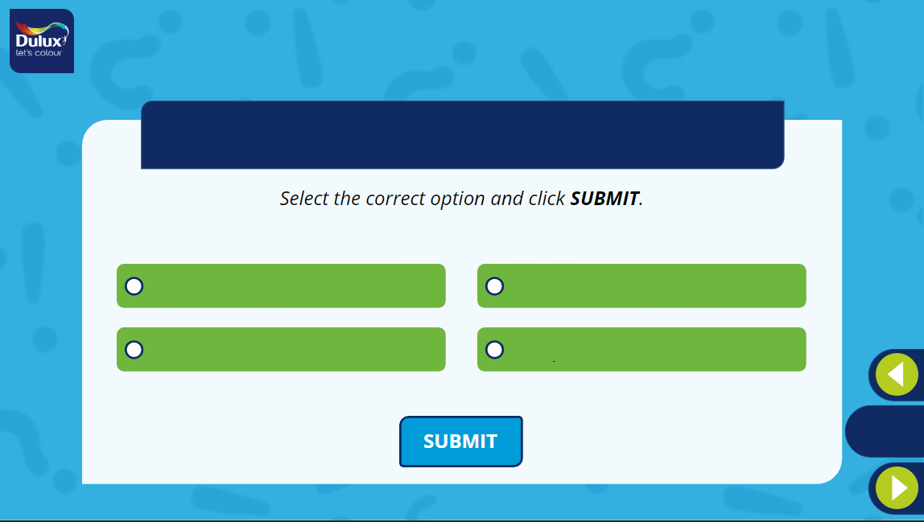
What is the unique thing about the Dulux Better Living Air Clean Biobased paints?
1
2
It has bio luminance property which makes it glow in the dark
It cleans the environment when applied to external surfaces
3
4
It has the highest sheen of all products
It has biobased ingredients which enable it to purify indoor air
Notes:
Developer Notes: Option 4 is the correct option.

Slide 32
What is the difference between the Dulux EasyClean and EasyClcean Plus?
Select all the options that apply and click SUBMIT.
(More than one option may be correct)
1
2
EasyClean Plus: Sheen Finish
EasyClean : Matt Finish.
EasyClean Plus: Solvent Based
EasyClean : Water Based.
3
4
EasyClean Plus: Kidproof+ technology
EasyClean : ColourGuard technology.
EasyClean Plus: Hard to clean
EasyClean: Hard to clean
Notes:
Developer Notes: Option1 and Option 3 are the correct options.

Slide 33
INTERIOR MASS & ECONOMY WALL PAINT

Slide 34
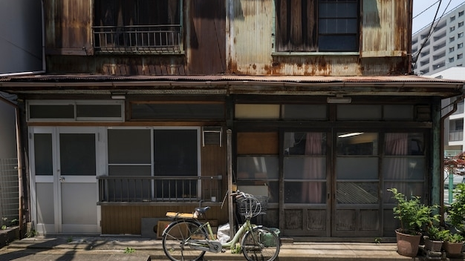

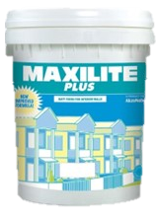
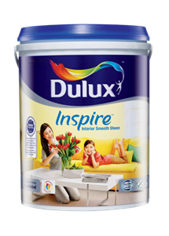
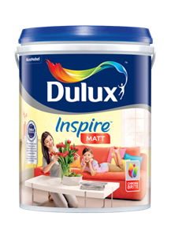
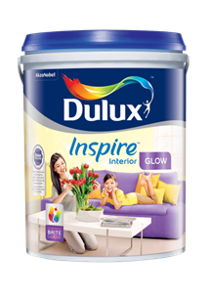
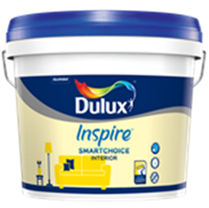
Overall Problem Statement
Ground Floor Hallway
Bedroom 1
Bedroom 2
Living Room
Attic
Notes:
VO: Bintang and his cousins Johan and Adelia live in their uncles small house in the southern part of the city. With the approaching festivals, they want to surprise their uncle by painting his house for him. They are looking for options to give their rooms and common areas a nice makeover. The top floor is especially in need of some repair. They want a high quality finish on a budget and are looking for options. Let’s see how Dulux’s range of paints can help them. There are several options they can choose from, however each room has a different requirement, let’s see how these different products help them.
Click the different rooms to see the different requirements.
Image Ref:
BG: https://www.freepik.com/free-photo/haunted-house-bicycle-background_28421132.htm#page=2&query=poor%20asian%20house&position=47&from_view=search&track=ais&uuid=910811ea-b5e4-4fc0-83e3-dbe6f372a9a2
Group: Image Ref: https://www.freepik.com/free-photo/medium-shot-smiley-friends-wearing-trucker-hats_26502258.htm#query=asian%20group%20of%20youngsters%20poor&position=45&from_view=search&track=ais&uuid=b316944a-c41b-4f54-a1b7-7de81b1bcf7a

Slide 35
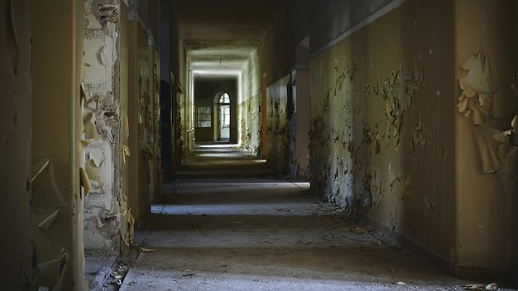
Ground Floor Hallway
Ground Floor Hallway
Notes:
VO: The hallway is always used by everyone living in the household. Walls get dirty quicker with smudges, hand prints and other stains. Dulux Inspire Interior – Glow is a perfect solution for this, as it offers a washable, high sheen paint finish at a budget. Click Next to proceed.
Image Ref: https://www.freepik.com/free-photo/hallway-abandoned-building-with-aged-walls-lights_10728678.htm#query=malaysian%20house%20hallway%20dirty&position=10&from_view=search&track=ais&uuid=070be648-0ee5-4d8f-ac6d-3d8895f3f752

Slide 36
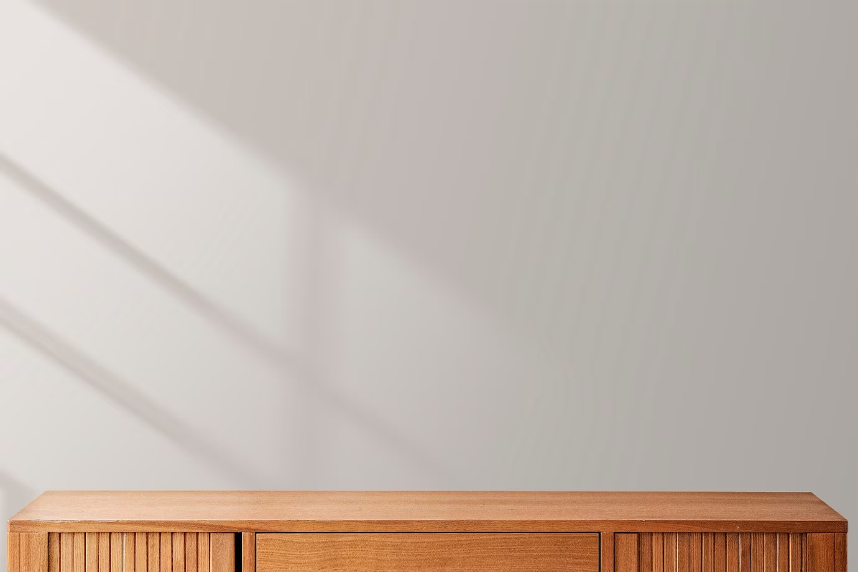
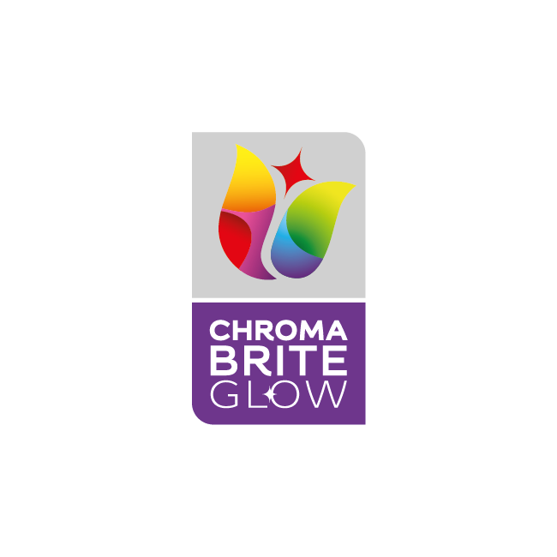
Introduction
Dulux Inspire Interior – Glow
ChromaBrite technology
High Sheen
Long lasting protection
Notes:
VO: Dulux Inspire Interior – Glow is a perfect solution for their bedroom, as it offers a washable, high sheen paint finish at a budget. Click next to view the features in detail.
Image Ref: https://www.freepik.com/free-photo/minimal-product-backdrop-with-wooden-cabinet_15667366.htm#query=wall%20with%20shelf&position=45&from_view=search&track=ais&uuid=03401b9d-5e02-493a-b83e-86ac6b56b47b

Slide 37
Features
Good Opacity
1 Ready mix
>2500 shades
Coverage:
10-11 mt²/Lt
mts²
Finish: High Sheen
1L, 5L & 18 L
Click the product to learn more.
Notes:
VO: Let's now check some extraordinary features of this product.
Finishes with a High sheen
Cover more space with less paint, with 10-11 square meters per liter.
Good Opacity to cover imperfections
Choose from over 2500 shares with a single ready mix
Available in 1, 5 and 18 litre packaging

Slide 38
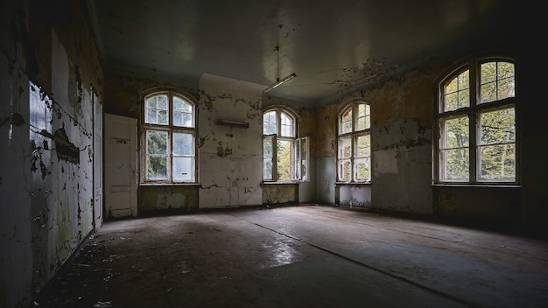
Living Room
Notes:
VO: The Living room needs a nice makeover. Everyone spends their free time here. Bintang thinks that they need the living room to be bright, colourful and have smooth shiny walls.
Click Next to proceed.
Image Ref: https://www.freepik.com/free-photo/beautiful-view-interior-old-abandoned-building_13292407.htm#query=dirty%20chinese%20living%20room&position=43&from_view=search&track=ais&uuid=839cf31f-de8a-433d-a2f1-3c368f10201a#position=43&query=dirty%20chinese%20living%20room

Slide 39

Introduction
Dulux Inspire Interior – Smooth Sheen
ChromaBrite technology
Mid Sheen finish
Long lasting protection
Notes:
VO: Dulux Inspire Interior – Smooth Sheen offers a mid sheen finish with Chroma Brite technology to offer long lasting protection. It is another washable paint that is cost effective too. This would suit their living room very nicely and also will not burn a hole in their pockets. Click next to view the features in detail.

Slide 40
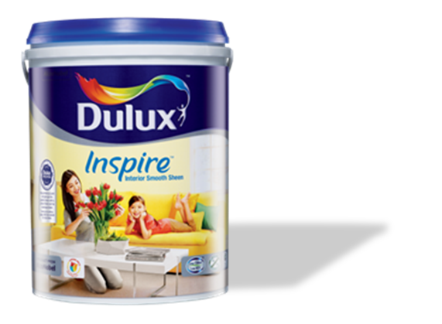
Features
Good Opacity
1 Ready mix
>2200 shades
Coverage:
10-11 mt²/Lt
mts²
Finish: Mid Sheen
1L, 5L & 18 L
Click the product to learn more.
Notes:
VO: Let's now check some extraordinary features of this product.
Finishes with a High sheen
Cover more space with less paint, with 10-11 square meters per liter.
Good Opacity to cover imperfections
Choose from over 2200 shares with a single
Available in 1, 5 and 18 litre packages.
Image Ref: https://www.freepik.com/free-photo/minimal-product-backdrop-with-wooden-cabinet_15667366.htm#query=wall%20with%20shelf&position=45&from_view=search&track=ais&uuid=03401b9d-5e02-493a-b83e-86ac6b56b47b

Slide 41
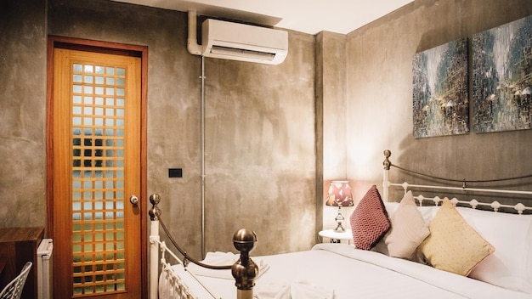
Bedroom 1
Notes:
The bedroom walls appear dull and dirty with years of usage and stains. This is Johan’s bedroom and he wants to have a matt finish to adorn these walls. Can you guess which would be the correct paint choice for him? Let’s take a look. Click next to proceed.
Image Ref: https://www.freepik.com/free-photo/interior-hotel-room-residence-is-furnished-modernly-copy-space-background_21849064.htm#page=2&query=indonesia%20bedroom%20dirty&position=43&from_view=search&track=ais&uuid=d7c87e93-c5ba-4862-9294-aff898032553

Slide 42
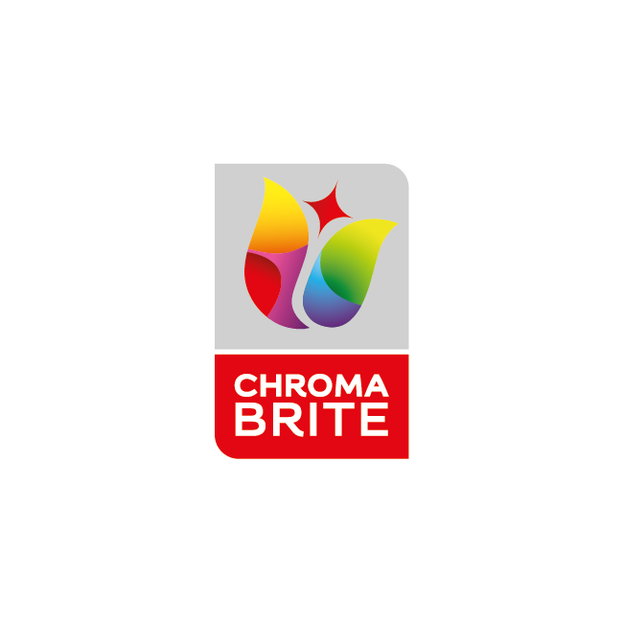
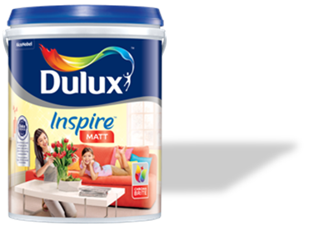
Introduction
Dulux Inspire Interior – Matt
ChromaBrite technology
Matt Finish
Long lasting protection
Notes:
VO: the Dulux Inspire Interior – Matt is an inexpensive option for getting that perfect matt finish on your walls. This also has the chroma bright technology which keeps walls looking fresher for longer. This seems ideal for Johan’s bedroom. Lets check out its features in detail in the next slide. Click next to proceed.

Slide 43
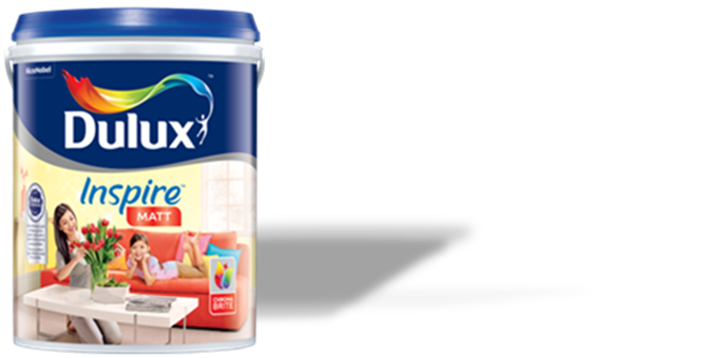
Features
Good Opacity
1 Ready mix
>2500 shades
Coverage:
10-12 mt²/Lt
mts²
Finish: Matt
1L, 5L & 18 L
Click the product to learn more.
Notes:
VO: Let's now check some features of this product.
Finishes with a Matt effect
Cover more space with less paint, with 10-12 square meters per liter.
Good Opacity to cover imperfections
Choose from over 2500 shares with a single
Available in 1, 5 and 18 litre packages.
Image Ref: https://www.freepik.com/free-photo/minimal-product-backdrop-with-wooden-cabinet_15667366.htm#query=wall%20with%20shelf&position=45&from_view=search&track=ais&uuid=03401b9d-5e02-493a-b83e-86ac6b56b47b

Slide 44
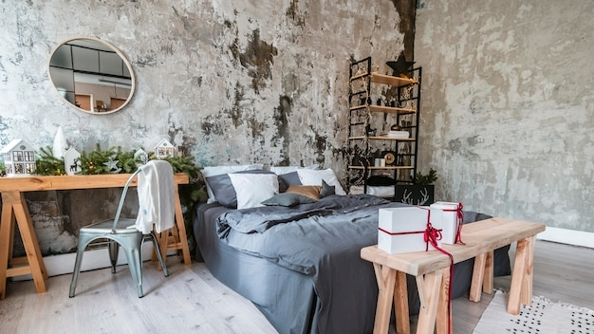
Bedroom 2
Notes:
VO: Bedroom 2 is where Adelia spends most of her time. She is fond of dark shades and want her room to reflect her personality. Let us see what Dulux has in store for her.
Image Ref: https://www.freepik.com/free-photo/room-interior-design_13195248.htm#query=dirty%20bedroom%20walls&position=14&from_view=search&track=ais&uuid=d55bd17b-2a77-49c5-a291-1810d9e0e545

Slide 45

Introduction
Dulux Inspire SmartChoice Interior
Affordable Choice
Good coverage
Better Opacity
Notes:
VO: Dulux Inspire SmartChoice Interior is a truly smart choice for Adelia’s bedroom. It is cost effective, gives good coverage and better opacity to hide the cracks and imperfections in the wall. Adelia thinks this product perfectly meets her expectations and requirements. Click next to view the features in detail.

Slide 46
Good Opacity
1 Ready mix
>2200 shades
Coverage:
10-12 mt²/Lt
mts²
Finish: Matt
7L & 18 L
Click the product to learn more.
Notes:
VO: Let's now check some features of this product.
Finishes with a Matt effect
Cover more space with less paint, with 10-12 square meters per liter.
Good Opacity to cover imperfections
Choose from over 2500 shares with a single
Available in 7 and 18 litre packages.
Image Ref: https://www.freepik.com/free-photo/minimal-product-backdrop-with-wooden-cabinet_15667366.htm#query=wall%20with%20shelf&position=45&from_view=search&track=ais&uuid=03401b9d-5e02-493a-b83e-86ac6b56b47b

Slide 47
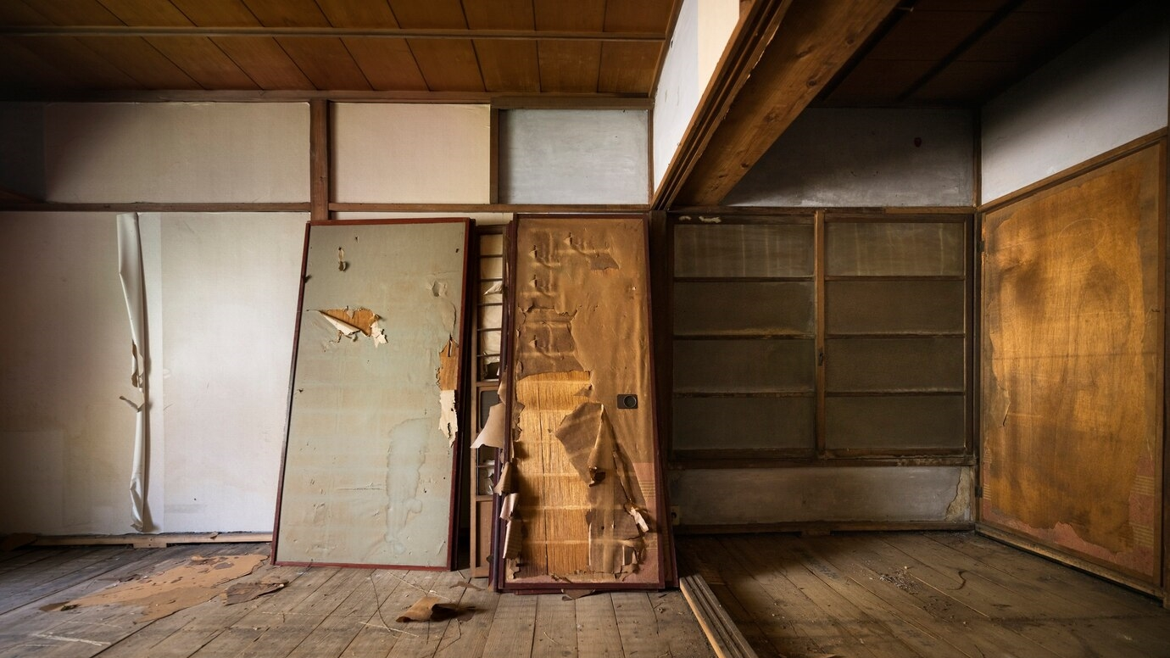
Attic
Notes:
VO: The attic is an area which needs a lot of repair. But as it is not used much, its often overlooked. Bintang wants to repair it and give it a cost effective solution to cover it up. Does Dulux offer any solution for such scenarios? Let’s find out.

Slide 48

Introduction
MAXILITE PLUS
Affordable Choice
Good coverage
Notes:
VO: Maxlite plus is one of the most cost effective paint solutions offered. Its Simple yet effective to give your often overlooked areas a fresh look. Let’s see its features next. Click Next. It has no added lead of mercury and is completely safe. Don’t you think this would be great for their attic? Click next to view the features in detail.

Slide 49
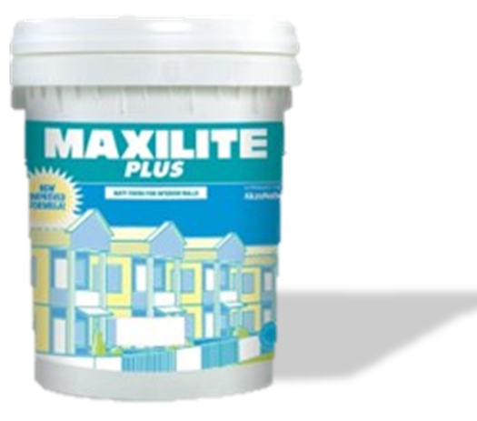
Basic Opacity
42 Ready mix
Coverage:
9 - 10 mt²/Lt
mts²
Finish: Matt
7L & 18 L
Click the product to learn more.
Notes:
VO: Let's now check some features of this product.
Finishes with a Matt effect
Cover more space with less paint, with 9-10 square meters per liter.
Basic Opacity to cover imperfections
Choose from over 42 Ready mix shades
Available in 7 and 18 litre packages.
Image Ref: https://www.freepik.com/free-photo/minimal-product-backdrop-with-wooden-cabinet_15667366.htm#query=wall%20with%20shelf&position=45&from_view=search&track=ais&uuid=03401b9d-5e02-493a-b83e-86ac6b56b47b

Slide 50

Results
Notes:
VO: Bintang and his cousins have found the best cost effective solution to give their uncles house a new makeover. Not only is his uncle happy with it, but they have great pride in doing the work themselves!
Image Ref: https://www.dulux.in/en/colour-inspiration/cut-through-neutrals-bright-bursts

Slide 51
Which of the following has the maximum paint coverage per litre of product?
1
2
Inspire SmartChoice Interior
Inspire Interior – Smooth Sheen
3
4
Maxlite Plus
Inspire Interior – Glow
Notes:
Developer Notes: Option 1 is the correct choice. Inspire SmartChoice Interior has 10-12 sq. mts of coverage per litre, while the others have 10-11 sq. Mts/Litre

Slide 52
EXTERIOR PREMIUM WALL & ROOF PAINT

Slide 53




Dulux Weathershield Powerflexx
Dulux Weathershield
Dulux Weathershield Roof
Click each product to learn more.
Notes:
VO: We have seen the Dulux products that make the inside of your home look magical. Lets take a look at the products which can protect and beautify the outside of your homes now. Click each paint can to know more about it.
Image Ref Background: https://www.freepik.com/free-photo/boards-with-unfocused-background_973019.htm#from_view=detail_author

Slide 54


I want to make this a heritage hotel…but…
These walls are so damaged, will this ever look good?
Notes:
VO: Melur has just purchased a colonial property close to the sea side. She plans to convert this into a heritage hotel. At the moment however the structure looks far from beautiful and inviting to any guests. The years of rain and sun have made the property look beat up. Also, there is water seepage and areas which need to be repaired before anything else. Let’s take a look how Dulux Weathershield Powerflexx is the perfect choice for Melur. Click Melur to understand her paint needs.
Image Reference: https://www.freepik.com/free-photo/historical-building-decaying_17120676.htm#query=old%20colonial%20house%20KL&position=43&from_view=search&track=ais&uuid=1b73db69-e0a1-4213-a569-8bfba06a3fde
(Melur) Image 2: https://www.freepik.com/free-photo/medium-shot-smiley-woman-outdoors_21745176.htm#query=adults%20indonesia&position=25&from_view=search&track=ais&uuid=586a4601-c487-453e-b4ad-4413adc99503
Developer Notes: Show the thought bubbles in sync with audio.

Slide 55



Introduction
Dulux Weathershield Powerflexx
Notes:
VO: The Dulux Weathershield Powerflexx is the ultimate protection that you can give your house. It has the Triple Defence Technology which provides ultimate crack proof, water repellent and ultimate weather resistant for your external walls. It also has a keep cool feature which rejects heat and keeps the property cool. Let us take a closer look at a use case of this product next. Click next to proceed.

Slide 56

Features
Coverage: Upto12 mt²/Lt
mts²
Warranty: 12 yrs.
Drying time:
2-3 hrs
Finish: Sheen
>2500 shades
Water based
1L, 5L & 18 L
Click the product to learn more.
Notes:
VO: Let's now check some extraordinary features of this product.
Water based environmentally friendly.
Finishes with a sheen
Has a warranty to last up to 12 years (warranty T&C available at: duluxweatherhsieldwarranty.com.my)
Cover more space with 12 square meters per liter.
Quick drying time of 2-3 hours.
Choose from over 2500 shares
Available in 3 sizes, which are1L, 5L and 18 Ltr buckets.

Slide 57
Result
Dulux Weathershield Powerflexx
Notes:
VO: Melur trusts the Dulux Weathershield Powerflexx to provide the ultimate protection to her new dream. The features are exactly what she was looking for, and the warranty of 12 years allows her to breathe easy and knows that the property will be protected from the elements for the next decade without her having to be worried.

Slide 58


Dulux Weathershield Powerflexx
Dulux Weathershield
Dulux Weathershield Roof
Click each product to learn more.
Notes:
VO: We have seen the Dulux products that make the inside of your home look magical. Lets take a look at the products which can protect and beautify the outside of your homes now. Click each paint can to know more about it.
Image Ref Background: https://www.freepik.com/free-photo/boards-with-unfocused-background_973019.htm#from_view=detail_author

Slide 59


Problem Statement
I need long lasting protection from the harsh sun and rain for my house. I wont mind spending a little extra for a warranty and peace of mind…
Notes:
VO: Ramanan had his house painted just two years ago. However, harsh weather conditions have made his walls look faded, cracked and about to crumble. He wants paint that will last years without needing maintenance. Click to see his thoughts.
Image Reference: https://www.freepik.com/free-photo/abandon-wall-window_4690148.htm#query=old%20colonial%20house%20KL&position=35&from_view=search&track=ais&uuid=1b73db69-e0a1-4213-a569-8bfba06a3fde
(Ramanan) Image 6:https://www.freepik.com/free-photo/confident-businessman_6765821.htm#page=3&query=adults%20malay&position=33&from_view=search&track=ais&uuid=83a2de5c-9804-48e1-a3ab-efb2da5d7d83

Slide 60



Introduction
Dulux Weathershield
Notes:
VO: The Dulux Weathershield is another top of the line products to protect exterior surfaces. It comes with Dulux Weathershield, with its Dualshield™ Technology, provides 2 times longer protection against colour fading, alkali, dirt and dust deposits and algae & fungus as compared to standard exterior paints. It has superior peel resistance and guards against algae and fungus too. Let’s dive deeper to understand this product better. Click Next to proceed.

Slide 61
Features
Coverage: Up to 12 mt²/Lt
mts²
Warranty: 7 yrs
Drying time:
2-3 hrs
Finish: Low
Sheen
>2500 shades
Water based
1L, 5L & 18 L
Click the product to learn more.
Notes:
VO: Let's now check some extraordinary features of this product.
Water based environmentally friendly.
Finishes with a sheen
Has a warranty to last up to 12 years (warranty T&C available at: duluxweatherhsieldwarranty.com.my)
Cover more space with 12 square meters per liter.
Quick drying time of 2-3 hours.
Choose from over 2500 shares
Available in 3 sizes, which are1L, 5L and 18 Ltr buckets.

Slide 62

Results
Dulux Weathershield
Notes:
VO: The Dulux Weathershield with its superior dualshield technology ensures that paint will last longer and fresher for years. This is the best option for Ramanan, and he is confident that he will not have to worry about his paint for many more years to come.
Image ref: (Ramanan) Image 6:https://www.freepik.com/free-photo/confident-businessman_6765821.htm#page=3&query=adults%20malay&position=33&from_view=search&track=ais&uuid=83a2de5c-9804-48e1-a3ab-efb2da5d7d83

Slide 63

Dulux Weathershield Powerflexx
Dulux Weathershield
Dulux Weathershield Roof
Click each product to learn more.
Notes:
VO: We have seen the Dulux products that make the inside of your home look magical. Lets take a look at the products which can protect and beautify the outside of your homes now. Click each paint can to know more about it.
Image Ref Background: https://www.freepik.com/free-photo/boards-with-unfocused-background_973019.htm#from_view=detail_author
.
****Need better image of Paint can for weathershild roof****

Slide 64


These roof tiles look so old and worn..
Problem Statement
Notes:
VO: Lee lives in a northern coastal city. His roof tiles always look dirty and damaged from the rain and the weather changes. Although the rest of his house is protected, the roof tiles let down the overall appearance of his home. He wants to change this. He has selected the Dulux Weathershield Roof for this reason. Click next view the benefits and features he will get from this paint.
BG: https://www.freepik.com/free-photo/closeup-shot-roof-shingles-houses-buildings-old-town_9991121.htm#query=malaysian%20house%20roof&position=27&from_view=search&track=ais&uuid=ba3de4bd-5f35-44fa-9590-6fc7c270e27e
Lee: Image 1: https://www.freepik.com/free-photo/calm-student-with-downtown-background_909198.htm#query=young%20adults%20indonesia&position=26&from_view=search&track=ais&uuid=4afd17de-a69a-4620-8b9d-bddb181389e7

Slide 65



Introduction
Dulux Weathershield Roof
Notes:
VO: Dulux Weathershield Roof comes with Colour Lock Technology, Algae/ Fungus Guard and Alkali Guard. This specially created formula shields your houses roof from heat, UV and other elements. This paint provides longer protection against colour fading, dirt and alkali to the roof tiles. Let’s take a look how it can help Lee with his roof tiles. Click next to proceed.

Slide 66
Features
Coverage: Up to 20 mt²/ 5 Ltr
mts²
Drying time:
2-3 hrs
Finish: Mid
Sheen
10 ready mix colours
Water based
5L & 18 L
Click the product to learn more.
Notes:
VO: Let's now check some extraordinary features of this product.
Water based formula
Finishes with a mid-sheen
Cover more space with 20 square meters per 5 liters of product.
Quick drying time of 2-3 hours.
10 ready mix colours. Only 3 selected popular colours available in the 18 Litre variant.
Available in 2 sizes, which are 5L and 18 Ltr buckets.

Slide 67


Result
Notes:
VO: Lee is very happy with the result of the Dulux Weathershield Roof paint on his house. The tiles look brand new and he is confident that they will stay this way for many more years to come.

Slide 68
Which of the features of the Dulux Weathershield Roof make it best suited for painting roofs?
1
2
It has Colour Lock Technology and great Algae/Fungus protection
It has the highest shine finish
3
4
It comes in small sized packaging of 1 litres
It had triple defense technology making it perfect paint
Notes:
Developer Notes: Option 1 is the correct answer.

Slide 69
EXTERIOR MASS WALL PAINT

Slide 70


Problem Statement
Tipah
Notes:
Tipah runs a homestay for travellers in the old part of the city. She is worried about the look of her external walls as the paint appears to be flaking and peeling in various places. Also, she doesn’t want to spend a huge deal of money as she prefers to paint it every few years and change the color and appearance of her homestay. She is looking for durable paint that will offer resistance against water, dirt, sun and weather elements in general. Let us see how the Dulux Inspire Exterior can be the perfect choice for Tipah.
(Tipah Image: ) Image 3: https://www.freepik.com/free-photo/woman-standing-outdoors_6803717.htm#query=adults%20indonesia&position=33&from_view=search&track=ais&uuid=586a4601-c487-453e-b4ad-4413adc99503
Image Reference: https://www.freepik.com/free-photo/blue-building-city-varanasi-india_3540091.htm#page=2&query=old%20colonial%20house%20KL&position=23&from_view=search&track=ais&uuid=1b73db69-e0a1-4213-a569-8bfba06a3fde

Slide 71

Introduction
Dulux Inspire Exterior
Notes:
VO: The exterior of the house has to deal with a lot more than the interior walls. It has to face constant temperature changes, sun rays, UV rays, rain and much more. The Dulux Inspire Exterior is a product that can safeguard external walls against all these factors and maintain them looking clean, fresh and stain free. The Chromabrite technology helps walls looking clean and fresh for a long time. Click Next to proceed.
Image Ref: https://www.freepik.com/free-photo/boards-with-unfocused-background_973019.htm#from_view=detail_author

Slide 72
Features
Coverage10-12 M2/ Litre
mts²
Basic Opacity
1 Ready mix, >2500 colours
Finish: Matt
1L, 5L & 18 L
Notes:
VO: Let's now check some extraordinary features of this product.
Finishes with a matt effect
Has Good Opacity to cover external defects and cracks
Cover more space with 10-12 square meters per liter.
Choose from over 2500 shares with 1 ready mix
Available in 3 sizes, which are1L, 5L and 18 Ltr buckets.

Slide 73
TRIMS PREMIUM PAINT

Slide 74

Problem Statement
Notes:
Siti, Barzin, Nadia and Ash are having a conversation in the office break out area. They have just been to their colleagues house and are awestruck by how beautiful the house and furniture was. However these friends also want to make their furniture and trims look beautiful and are wondering how to go about it. Click each member to find out what they want to work on and how Dulux paints can help them.

Slide 75
Problem Statement
Notes:
Siti, who stays in her rented apartment says that my furniture needs to be changed, but I don’t have the budget to do it yet. Instead, I want to renovate my existing furniture so that it looks new again. How can I do it?

Slide 76



Introduction
Dulux Aura High Gloss
Notes:
VO: The Dulux Aura High Gloss is a premium paint that can be used on metal and wood surfaces on both internal and external surfaces. Its Diamond Strong technology gives excellent color and gloss to wood and metal trims. This is a great solution for Siti who wants to renew her furniture and trims. Let’s look at its features in detail. Click Next to proceed.

Slide 77

Features
Solvent based
Ready mix – 43 colours. Tinting up to 2000 colours
2x
Opacity:
2 Coats
Excellent colour fastness
Coverage:
16-18 mt²/Lt
mts²
durability & fungus resistance
Finish: High
Gloss
1L and 5L
Click the product to learn more.
Notes:
VO: Let's now check some extraordinary features of this product.
Finishes with a high gloss on both metal and wood trims
Cover more space with 16 -18 square meters per liter
Has Good Opacity with 2 coats
Solvent based formula
Choose from 43 ready mix and tinting up to 2000 colours
Excellent colour fastness
Excellent durability and fungus resistance
Available in 2 sizes, which are1L, and 5L buckets.

Slide 78
Problem Statement
Notes:
Barzin also wants his doors, window frames and other furniture to look good. He wants to match his trims to his other paint schemes and is looking for something which gives good colours, low smell and not very expensive. Let us see the best product for him. Click Next to proceed.

Slide 79


Introduction
Dulux Aura Gloss
Notes:
VO: Dulux Aura Gloss has Diamond Strong technology, which provides excellent color & gloss retention. It is also Green Label certified from Singapore. It has low odour and Low VOC.

Slide 80


Features
Water based
Ready mix – 43 colours. Tinting up to 2000 colours
2x
Opacity:
2 Coats
VOC
Free
Low VOC
Coverage:
10-12 mt²/Lt
mts²
Low Odour
Finish: High
Gloss
1L and 5L
Click the product to learn more.
Notes:
VO: Let's now check some features of this product.
Finishes with a gloss on both metal and wood trims
Cover more space with 10 -12 square meters per liter
Has Good Opacity with 2 coats
Water based formula
Choose Black and White ready mix and tinting up to 2000 colours
Low Odour
Low VOC
Available in 2 sizes, which are1L, and 5L buckets.

Slide 81
Problem Statement
Notes:
VO: Nadia too is inspired by her colleagues and wants to get her trims repainted. However, she is not fond of the high gloss look instead she prefers a satin matt finish to be kept consistent. Let’s look at the options that she can use.

Slide 82

Introduction
Dulux Aura Satin Matt
Notes:
VO: Dulux Aura Satin Matt has Diamond Strong technology, which provides excellent color & gloss retention. It has low odour and Low VOC and most importantly finished with a satin matt effect which is a key differentiator for some. Lets deep dive into the features of this product. Click next to proceed.

Slide 83

Features
Water based
Ready mix and tinting up to 2000 colours
2x
Opacity:
2 Coats
VOC
Free
Low VOC
Coverage:
10-12 mt²/Lt
mts²
Low Odour
Finish:
Satin Matt
1L and 5L
Click the product to learn more.
Notes:
VO: Let's now check some extraordinary features of this product.
Finishes with a satin matt effect.
Cover more space with 10 -12 square meters per liter
Has Good Opacity with 2 coats
Water based formula
Choose Black and White ready mix and tinting up to 2000 colours
Low Odour
Low VOC
Available in 2 sizes, which are1L, and 5L buckets.

Slide 84
Problem Statement
Notes:
Ash sounds impressed with the range of Dulux products so far. However, he enquires whether there is any pre-treatment required before these trims can be painted for best effects. And to answer this very important question, lets take a look at the pre-treatment options that need to be taken into account.

Slide 85



Introduction
Dulux Aura Metal Grey Green Zinc Phosphate
Dulux Aura Speed Undercoat
Dulux Aura Wood & Metal Primer
Notes:
VO: Pre-treatment of metal and wood surfaces is as important as the top coat that makes them stand out and look good. The correct method and system needs to be followed to get the perfect desired finish. Let’s take a look at each of these in detail.

Slide 86
Introduction
Dulux Aura Speed Undercoat
1x
Solvent based
Opacity:
1 Coats
Coverage:
13 mt²/Lt
mts²
1L and 5L
Finish:
Satin Matt
Quick dry, Alkali Resistant
Notes:
VO: First, we have the Dulux Aura Speed Undercoat. This is an acrylic copolymer based undercoat that is suitable for both wood and metal surfaces. It also has stain sealing properties and alkali resistance and can be applied on Cementious substrates too. It has a Satin Matt finish, covers upto 13 sq. mts per litre and 1 coat is sufficient to cover stains and imperfections. It is available in a white – ready mix state and is solvent based.

Slide 87

Introduction
Dulux Aura Metal Grey Green Zinc Phosphate
1x
Solvent based
Opacity:
1 Coats
Coverage:
11 mt²/Lt
1L and 5L
mts²
Notes:
VO: Next, we have the Dulux Aura Metal Grey Green Zinc Phosphate. This is an solvent based anti corrosive primer. This is suitable for both interior and exterior metal surfaces that may be steel, zinc, galvanized iron or even aluminium. A single litre helps cover 11 sq meters of area and a single coat is enough to get the right opacity. It is solvent based, comes in a ready mix gray/green colour and is available in 1 and 5 litre cans.

Slide 88
Introduction
Dulux Aura Wood & Metal Primer
1x
Water based
Opacity:
1 Coats
Coverage:
9-10 mt²/Lt
1L and 5L
mts²
Notes:
VO: Next, there is the Dulux Aura Wood and Metal Primer. It can be used for both metal and wood surfaces and does not have the typical strong odour of solvent based primer. A single coat is enough to provide opacity, and the coverage is for 9-10 sq. mts with a single litre of primer. It is water based and comes in a single ready mix – white. There are 1 litre and 5 litre configurations available. It has good adhesion and it also prevents rusting of metal surfaces.

Slide 89
Results
Notes:
All of the friends have now understood how to make their trims and furniture pieces look great again. They are convinced that if they use the right pre-treatment and trim/enamels, their furniture will spring back to life and look great complementing their houses!
Developer Notes: Image of 4 people giving thumbs-up is required here.

Slide 90
Which of the following products are best suited for metal primers for external applications?
1
2
Dulux Aura Metal Grey Green Zinc Phosphate
Dulux Aura Speed Undercoat
3
4
Dulux Aura Gloss
Dulux Inspire Exterior
Notes:
Developer Notes: Options 1, 2 and 3 are correct. Option 4 is incorrect. Dulux Inspire Exterior is not a pre-treatment primer.

Slide 91
TRIMS MASS PAINT

Slide 92


Problem Statement
Shanzey
Notes:
Shanzey has just purchased a new sofa for her flat. She wants the rest of the flat to be colour matched with her new sofa. She wants her windows and doors to also match her furniture. She is looking for inexpensive paint options that will enable her to create the theme she is looking for. Let’s take a look at the Dulux Inspire Gloss series and see how it allows her to customize her existing wooden furniture and trim.
Image Ref: ) Image 5: https://www.freepik.com/free-photo/young-beautiful-girl-wearing-muslim-hijab-standing-isolated-pink-background-happy-face-smiling-with-crossed-arms-looking-camera-positive-person_39512472.htm#query=adults%20malay&position=49&from_view=search&track=ais&uuid=83a2de5c-9804-48e1-a3ab-efb2da5d7d83 (Shanzey)

Slide 93




Introduction
Dulux Inspire Gloss
Notes:
VO: The Dulux Inspire Gloss. Like the rest of the Inspire series, contains advanced chroma brite technology which keeps wood and metal surfaces remain bright and fresh for years. It will give her furniture a smooth finish with bright colours that stay fresh for a long time. Lets take a look at the features it offers. Click next to continue.

Slide 94

Introduction
Dulux Inspire Gloss
2x
Solvent based
Opacity:
2 Coats
Coverage:
16 mt²/Lt
mts²
1L and 5L
Finish:
Gloss
Smooth finish
Notes:
VO: Let's now check some extraordinary features of this product.
Finishes with a gloss on both metal and wood trims
Cover more space with 16 square meters per liter
Has Good Opacity with 2 coats
Solvent based formula
Choose Black and White ready mix and tinting up to 2000 colours
Bright colours and smooth finish
Available in 2 sizes, which are1L, and 5L buckets.
Icon Reference (Smooth): https://www.flaticon.com/free-icon/feather_7765746?term=smooth&page=1&position=3&origin=search&related_id=7765746

Slide 95


Results
Notes:
VO: Thanks to Dulux Inspirse Gloss, Shanzey now has matching windows and woodwork in her flat. The furniture looks beautiful and compliments her new sofa and interior theme.

Slide 96
WOODCARE PREMIUM PAINT

Slide 97


Problem Statement
Notes:
VO: Alex has bought the house where he grew up as a child. However, because of disuse, it does not look like the childhood home from his memories. He intends to completely renovate the house both from inside and outside and wants it to be a modern and comfortable home for him and his family. Since the house is old, it has a lot of wood in it and the wood looks old and worn. Alex wants a solution to preserve the old look and feel, yet protect it and shield it from damage for the future. Let’s see how Dulux Woodcare can help him achieve this transformation.
Image ref: Background: https://www.freepik.com/free-photo/beautiful-japanese-garden_24999142.htm#query=asian%20villa%20with%20fence&position=29&from_view=search&track=ais&uuid=26891587-3930-49ea-b0b4-743d2a3415bd
Image character: https://www.freepik.com/free-photo/happy-moment-back-view-man-gesturing-hugging-woman-with-keys-looking-each-other_22265004.htm#query=Asian%20Family%20looking%20at%20house&position=13&from_view=search&track=ais&uuid=1d550a18-abad-40a0-bb38-b430340f00d8

Slide 98




Dulux Woodcare Range
Dulux Woodcare Timbertone
Dulux Woodcare Timbercolour
Dulux Woodcare Satinwood
Dulux Woodcare Solarscreen
Click each product to learn more.

Slide 99


Introduction
Dulux Woodcare Satinwood
Notes:
VO: The Dulux Woodcare Satinwood is perfect for restoring and protecting your old furniture. It gives a smooth satin like texture with long lasting protection to both wooden and metallic surfaces. Click next to view its features in details.
Image ref: https://www.freepik.com/free-vector/different-designs-wooden-chairs_1046921.htm#query=wooden%20chair&position=0&from_view=search&track=ais&uuid=b6f08e0a-9022-4b0d-9e12-d342b2eb4658#position=0&query=wooden%20chair

Slide 100
Features
Dulux Woodcare Satinwood
2x
Solvent based
Opacity:
2 Coats
Coverage:
12 mt²/Lt
mts²
1L and 5L
Finish:
Satin
Smooth finish
Notes:
VO: Let's now check some extraordinary features of this product.
Finishes with a egg-shell like satin finish
Cover more space with 12 square meters per liter
Has Good Opacity with 2 coats
Solvent based formula
Choose 4 ready mix colours
Resistant to scrathces
Available in 2 sizes, which are1L, and 5L buckets.

Slide 101

Dulux Woodcare Timbertone
Introduction
Wood Panels
Parquet Flooring
Wooden furniture
Notes:
VO: The Dulux Woodcare Timbertone is a polyurethane-reinforced varnish for the protection and decoration of all wood surfaces. It can be applied to parquet flooring, wood paneling, wooden doors and furniture. (Show the secondary image and name tags in sync with audio) This product highlights the natural wood grains and brings out the beauty in your furniture. It is available in clear glossy & satin and a also selection of glossy natural colors and offers good resistance to scratches and stains.
Image ref: https://www.freepik.com/free-photo/mid-century-modern-living-room-interior-design-with-monstera-tree_17851154.htm#query=wooden%20chair&position=3&from_view=search&track=ais&uuid=b6f08e0a-9022-4b0d-9e12-d342b2eb4658

Slide 102

Features
Dulux Woodcare Timbertone
3x
Solvent based
Opacity:
2 Coats
Coverage:
15 mt²/Lt
mts²
1L and 5L
Finish:
Clear Gloss or
Satin
Highlights woodgrains
Notes:
Image Ref: Wood Grains: https://www.flaticon.com/free-icon/wood_939561?term=wood&page=1&position=46&origin=search&related_id=939561 (Last Icon)
VO: Let's now check some extraordinary features of this product.
Finishes with either a clear gloss or satin finish
Cover more space with 15 square meters per liter
Has Good Opacity with 3 coats
Solvent based formula
Choose from 12 ready mix colours
Highlights the natural wood grains and texture
Available in 2 sizes, which are1L, and 5L buckets.

Slide 103


Introduction
Dulux Woodcare Timbercolour
Notes:
VO: Dulux Woodcare Timbercolour is an acrylic paint that gives exterior furniture, walls & fences a low sheen finish. This paint can be applied on timber and galvanized iron substrates and offers resistance against algae and fungi. It reduces impact of weathering on external wooden surfaces.

Slide 104



Features
Dulux Woodcare Timbercolour
2x
Water based
Opacity:
2 Coats
Coverage:
12 mt²/Lt
mts²
1L and 5L
Finish:
Low Sheen
Algae, fungus protection
Notes:
VO: Let's now check some extraordinary features of this product.
Finishes with either a low sheen finish
Cover more space with 12 square meters per liter
Has Good Opacity with 2 coats
Water based formula
Choose from 200 colours
Available in 2 sizes, which are1L, and 5L buckets.
Provides good protection against weathering, algae and fungii

Slide 105


Introduction
Dulux Woodcare Solarscreen
Notes:
VO: Dulux Woodcare Solarscreen is a durable pigmented varnish specially formulated to provide long-lasting weather protection for all types of wood surfaces. It provides good film clarity and highlights the natural wood grains. It also good adhesion and flexibility. Its unique formulation filters out UV rays thereby minimizing the traditional weathering related problems of cracking, flaking and peeling.
Image Ref: https://www.freepik.com/free-photo/beautiful-shot-field-full-yellow-flowers-trees-old-wooden-fence_10399861.htm#query=fence%20painting&position=23&from_view=search&track=ais&uuid=32bb16b6-5ed4-4b73-a9e9-37789a2aea25

Slide 106


Features
Dulux Woodcare Timbercolour
2x
Solvent based
Opacity:
2 Coats
Coverage:
15 mt²/Lt
mts²
1L and 5L
Finish:
Gloss
Highlights wood grains
Notes:
VO: Let's now check some extraordinary features of this product.
Finishes with either a Gloss finish
Cover more space with 15 square meters per liter
Has Good Opacity with 2 coats
Solvent based formula
Choose 18 ready mix colours
Available in 2 sizes, which are1L, and 5L buckets.
Provides good protection against cracking, peeling and flaking

Slide 107
Which of the following products help in bringing out the wood grains and enhance the appearance of wooden furniture?
1
2
Dulux Woodcare Satinwood
Dulux Woodcare Timbertone
3
4
Dulux Woodcare Timbercolour
Dulux Woodcare Solarscreen
Notes:
Developer Notes: Option 2, Timberton is the right answer. In addition to this, it provides Resistance to scratches & stains, has Great gloss retention and Great film clarity

Slide 108
WATERPROOFING PREMIUM PAINT

Slide 109


Problem Statement
Abdalla
Notes:
VO: Abdalla lives in the southwestern coastal part of the country which gets a lot of rainfall throughout the year. As a result, Abdalla’s roof is exposed to a lot of water and rain and it has now started to leak into his house. Due to this, his walls have started showing damp patches, and his ceiling is stained in many places. Abdalla is looking for a permanent solution to keep the damp out and the keep his walls and ceiling looking tip-top.

Slide 110



Introduction
Dulux Aquatech Max Waterproofing
Notes:
VO: Dulux Aquatech Max waterproofing is a premium water proofing solution both for interiors and exteriors. It contains Hydroresist Technology, which forms an impenetrable, tough film over porous walls that is highly flexible which bridges cracks preventing water seepage, carbonation and fungal attacks.
Image Ref: Input deck Malaysia slide 34.

Slide 111
Features
Dulux Aquatech Max Waterproofing
3x
Opacity:
3 Coats
Water based
5 kg and
20 kg
Coverage:
15 mt²/Lt
mts²
Notes:
VO: Let's now check some extraordinary features of this product.
Cover up to 1.2-1.4 kg/ m2
Has Good Opacity with 3 coats
Water based formula
2 Ready mix colours – Grey and White
Available in 2 sizes, which are kg, and 20kg buckets.
Excellent waterproofing, foot traffic does not affect coating.

Slide 112
Results
Notes:
VO: With the application of Dulux Aquatech Max Waterproofing, the cracks in Abdalla’s roof have been filled and repaired and a flexible waterproof layer has been added. This will ensure that in future, Abdalla will not get any dampness or stained walls as a result of leaking roof.

Slide 113
In how many colours is the Dulux Aquatech Max Waterproofing offered?
1
2
1 colour - Black
3 Colours – Red, Marroon and Brown
3
4
2 colours - Grey & White
More than1000 colours
Notes:
Developer Notes:
Option 3 is correct. The Dulux Aquatech Max Waterproofing is offered in 2 colours - Grey & White.

Slide 114
PRE DECO

Slide 115


Problem Statement
Notes:
VO: Martha had recently repainted the house and fence repainted. However within a couple of years, its all starting to peel away. The walls look faded, the roof has completely lost its shine and the fence has blisters all over it. She is not sure why the paint has deteriorated so quickly. On closer inspection it seems that the paint has not lasted because of poor pre-processing. The primer and sealer used was of inferior quality which has made the expensive paint go bad very quickly. Martha wonders how she can avoida similar situation this time. Let’s help Martha. Click next to proceed.
Image reference: https://www.freepik.com/free-photo/contrasting-outdoor-texture-design_32887698.htm#page=6&query=peeling%20paint%20fence&position=37&from_view=search&track=ais&uuid=90582494-99b1-4e0b-8967-6fc608106c73

Slide 116




Introduction
Dulux Weathershield Sealer (Water-based)
Dulux Weathershield Roof Primer
Dulux Exterior & Interior Sealer (Water-based)
Dulux Weathershield Sealer (Water-based)
Notes:
VO: It appears that not only is good quality paint important to keep your walls and trim looking great, but it is equally important to use the right Sealers, primers and putty. Also the painting system should be followed thoroughly to keep paint from peeling, cracking and deteriorating. Dulux has the following Sealers and Primers that should be used before you paint your property. Lets look at each on in greater detail to understand its uses. Click each can to know more.

Slide 117
Benefits and Features
Dulux Weathershield Sealer (Water-based)
Water based
Matt finish
Covers up to 10 sq. mts /litre
Ready-mix White
5 Litre and 18 Litre packaging
Notes:
Dulux Weathershield Sealer is a premium water-based sealer is specially designed to promote strong adhesion of topcoat onto new walls and prevent wall paint from peeling and cracking. It works as a system with Dulux Weathershield range topcoats to deliver a better finish that is guaranteed to last longer. It is a water based sealer and comes with a Matt finish. It covers up to 10 m2/litre and comes in a ready-mix white colour. It comes in 5 and 18 litre packaging.

Slide 118

Benefits and Features
Solvent based
Matt finish
Covers up to 10 sq. mts /litre
Ready-mix White
5 Litre and 18 Litre packaging
Dulux Weathershield Sealer (Water-based)
Notes:
Dulux Weathershield Primer is a premium solvent-based primer is specially designed to promote strong adhesion of topcoat onto the repainted walls. This prevents wall paint from peeling and cracking and it provides good penetration on powdery surfaces and work as a system with Dulux Weathershield range topcoats to deliver a better finish that lasts for longer. This gives a matt finish, covers up to 10 sq. Mts/litre and comes in a standard white ready mix form. It also comes with a guarantee and is available in 5 and 18 litre packaging.

Slide 119
Benefits and Features
Solvent based
Matt finish
Covers up to 20 sq. mts /litre
Ready-mix Grey
5 Litre and 18 Litre packaging
Dulux Weathershield Roof Primer
Notes:
Dulux Weathershield Roof Primer is a premium solvent-based primer specially made for Roofs. It improves Weathershield roof paint adhesion to old and weathered roofs and works as a system with Dulux Weathershield Roof topcoat to deliver a better finish that lasts for longer. This also has a matt finish like the other primers. It has large coverage of up to 20 sq. mts/litre and comes in a premixed grey colour. This also comes in 5 and 18 litre packaging.

Slide 120
Benefits and Features
Water based
Matt finish
Covers up to 10 sq. mts /litre
Ready-mix White
5 Litre and 18 Litre packaging
Dulux Exterior & Interior Sealer (Water-based)
Notes:
Dulux Water based sealer promotes adhesion of new paints onto painted substrate. It is specially developed to work as a system with Dulux interior and exterior topcoats to deliver a better finish that lasts longer. This comes in a matt finish and covers up to 11 sq. mts/litre of product. It is available in ready mix white option and comes in standard packaging of 5 and 18 litres.

Slide 121


Result
Notes:
VO: Voila! Look at what a transformation this has brought about! Martha has used the correct primers and top coats and her fence now looks as good as new! She is very happy with the result.
Image Ref: https://www.freepik.com/free-photo/red-vertical-striped-wood-background-texture_1137359.htm#query=fresh%20red%20fence&position=20&from_view=search&track=ais&uuid=8a1c3db0-0c75-4ee5-8d3f-febd6c7cd019
Image Ref 2: Character: https://www.freepik.com/free-photo/horizontal-shot-good-looking-confident-happy-female-entrepreneur-standing-self-assured-feminine-pose-gray-wall-stylish-outfit-pointing-right-folding-lips-cute_10401832.htm?query=asian%20woman%20frustrated#from_view=detail_alsolike#position=2&query=asian%20woman%20frustrated

Slide 122

Notes:
Its time to assess your knowledge on the Dulux Products we covered in this training.

Slide 123

Notes:
Please read the instructions carefully before starting. All the best. Click Start to begin.

Slide 124

What does the Chroma Brite technology do?
It helps make the room bright
It makes wall defects clearly visible
It keeps walls looking brighter for longer
It seals wall cracks
Notes:
What does the Chroma Brite technology do?
Answer: It keeps walls looking brighter for longer
Incorrect options: It gives walls a dull appearance
It makes wall defects clearly visible
It helps make the room bright

Slide 125
Which of the following paints is an external weatherproof paint solution?
Dulux Woodcare Satinwood
Dulux Weathershield Powerflexx
Dulux Aquatech Max Waterproofing
Dulux Weathershield Primer

Slide 126
Select the benefits of Dulux EasyClean Plus with Kidproof technology. (More than one option is correct)
It makes cleaning walls easier
It has virus and bacteria protection
It adds a glow to your walls
It is designed to be applied by children

Slide 127
Which technology does the Dulux Aqautech Max Waterproofing use to create a impenetrable, tough film over roof surfaces?
Hydrotight Technology
Hydroresist Technology
Leakproof Technology
Kidproof Technology

Slide 128





Lee
Melur
Tipah
Abdalla
Shanzey
Ramanan
Notes:
(Lee) Image 1: https://www.freepik.com/free-photo/calm-student-with-downtown-background_909198.htm#query=young%20adults%20indonesia&position=26&from_view=search&track=ais&uuid=4afd17de-a69a-4620-8b9d-bddb181389e7
(Melur) Image 2: https://www.freepik.com/free-photo/medium-shot-smiley-woman-outdoors_21745176.htm#query=adults%20indonesia&position=25&from_view=search&track=ais&uuid=586a4601-c487-453e-b4ad-4413adc99503
(Tipah) Image 3: https://www.freepik.com/free-photo/woman-standing-outdoors_6803717.htm#query=adults%20indonesia&position=33&from_view=search&track=ais&uuid=586a4601-c487-453e-b4ad-4413adc99503
(Abdalla) Image 4: https://www.freepik.com/free-photo/young-latin-man-wearing-casual-clothes-with-happy-cool-smile-face-lucky-person_45186510.htm#query=adults%20malay&position=10&from_view=search&track=ais&uuid=83a2de5c-9804-48e1-a3ab-efb2da5d7d83
(Shanzey) Image 5: https://www.freepik.com/free-photo/young-beautiful-girl-wearing-muslim-hijab-standing-isolated-pink-background-happy-face-smiling-with-crossed-arms-looking-camera-positive-person_39512472.htm#query=adults%20malay&position=49&from_view=search&track=ais&uuid=83a2de5c-9804-48e1-a3ab-efb2da5d7d83
(Ramanan) Image 6:https://www.freepik.com/free-photo/confident-businessman_6765821.htm#page=3&query=adults%20malay&position=33&from_view=search&track=ais&uuid=83a2de5c-9804-48e1-a3ab-efb2da5d7d83

